Slide 1
OUN Prisoners in the Buchenwald Subcamp Mittelbau-Dora: A Microhistory
Orysia Maria Kulick
2018 Danyliw Seminar,
Chair of Ukrainian Studies, University of Ottawa,
8-10 November 2018

Slide 3
IG Farben 1932
Origins of Dora
This is the layout of IG Farben plants in 1932. At the suggestion of IG Farben, the gypsum mountain near Nordhausen was further developed in 1936 to serve as a centrally located fuel depot for the Wehrmacht. The aim was not only to be able to support troops on all fronts of a total war, but to make sure that IG Farben's factories remain supplied.

Slide 4
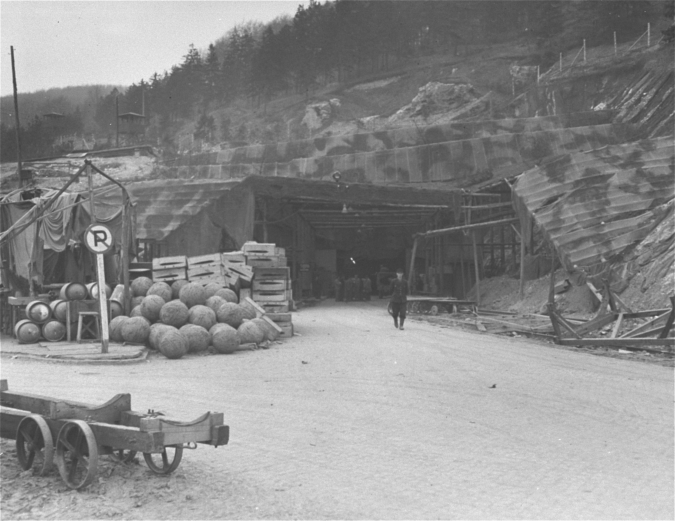
Camouflaged entrance to Dora

Slide 7
“Dora, the Hell of all the concentration camps.”
–Dr. Edwin Katzenellenbogen, convicted and sentenced to life imprisonment in the Buchenwald trial.

Slide 10
Microhistory: Asking large questions in small places.
–Charles Joyner
Shared Traditions: Southern History and Folk Culture, 1999

Slide 11
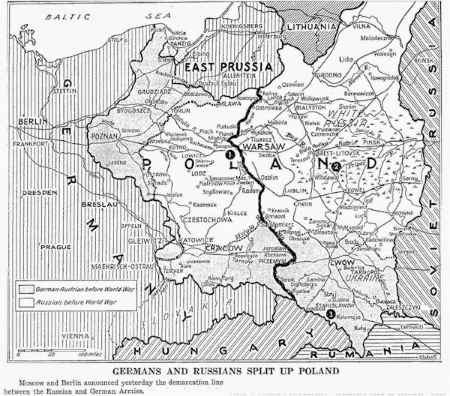
Molotov-Ribbentrop Line

Slide 12
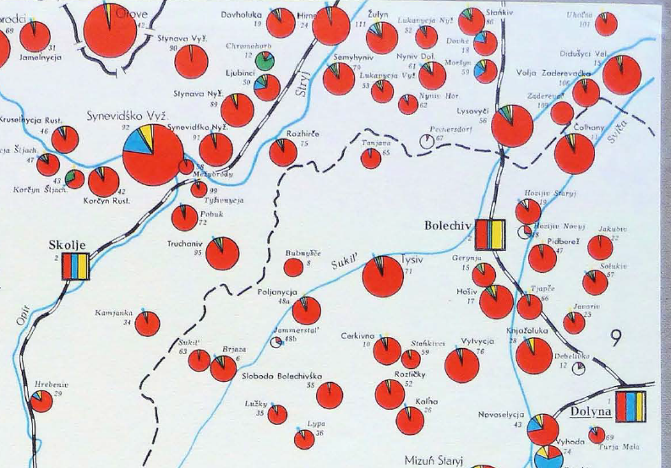
Stryj powiat, 1939

Slide 13
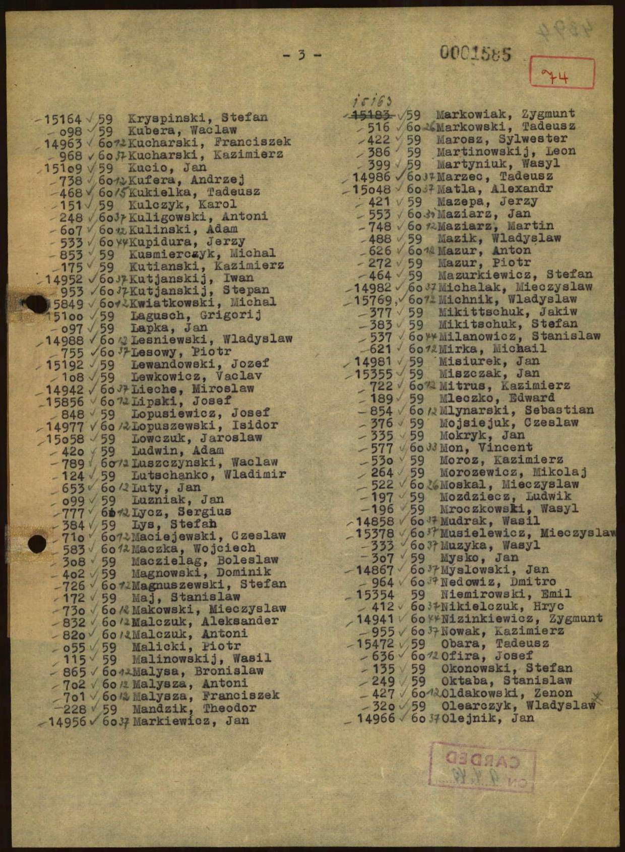

Slide 15
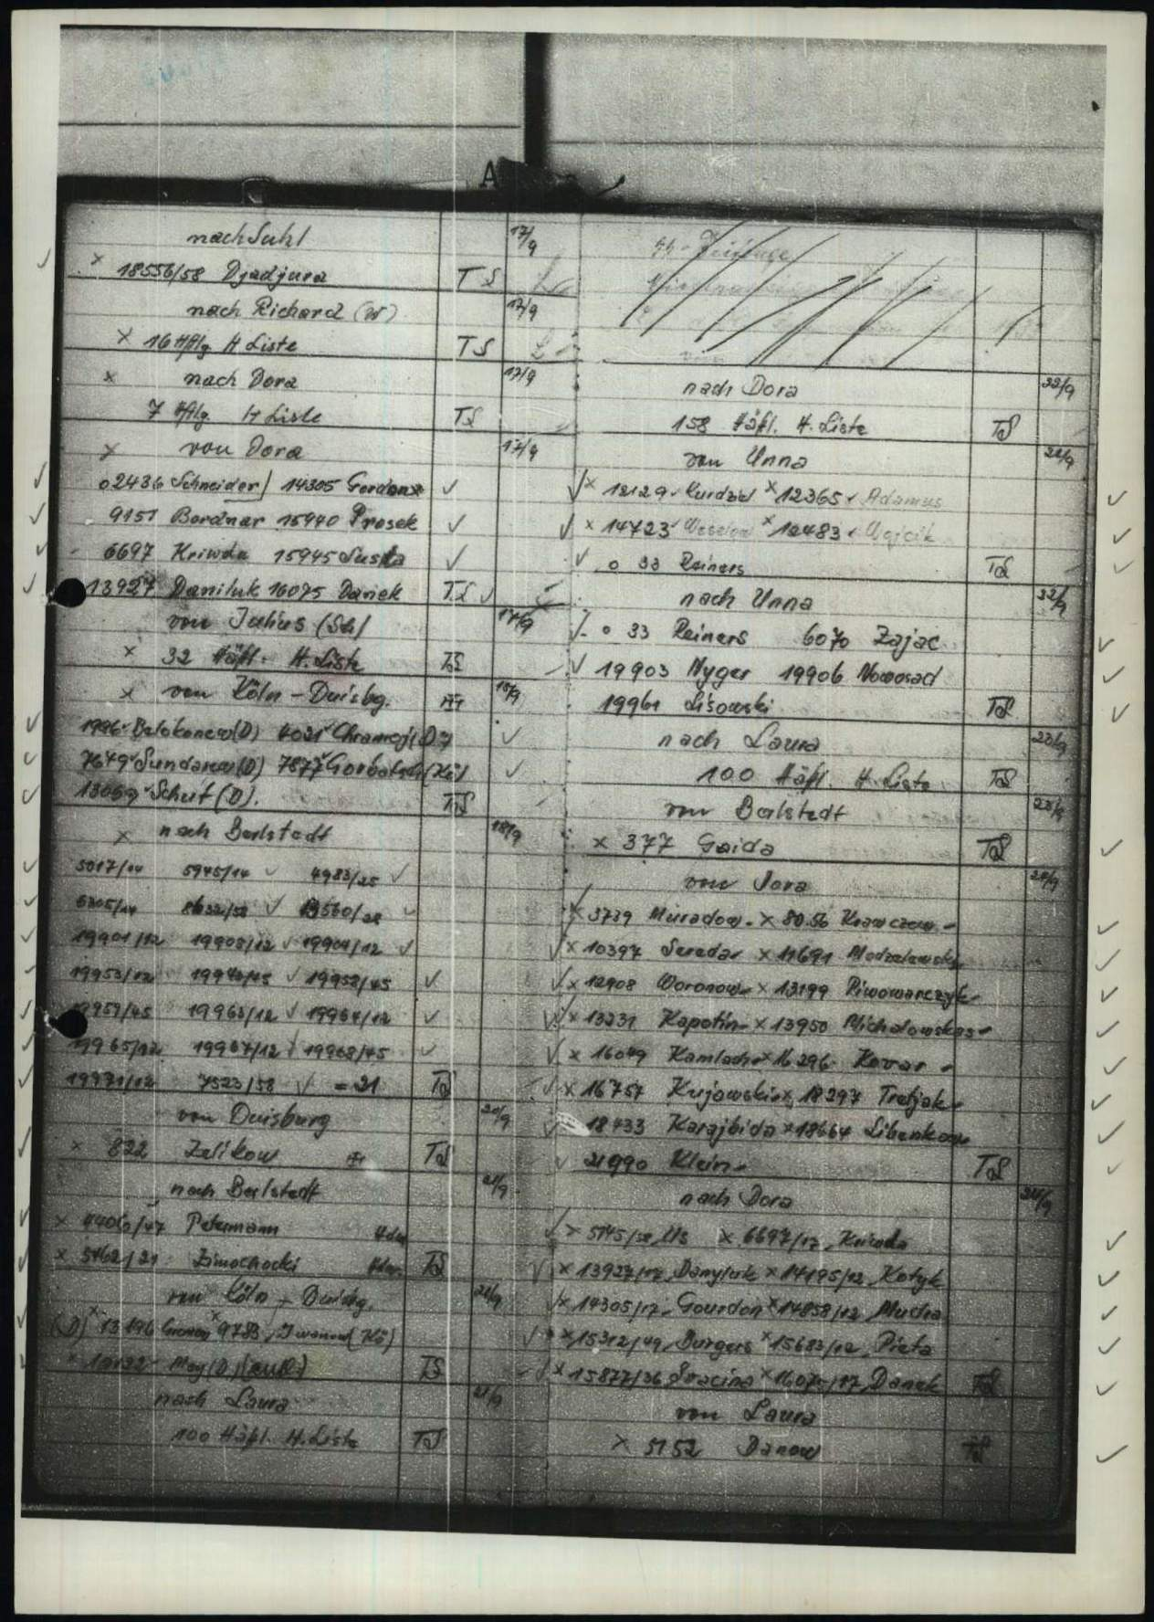

Slide 17
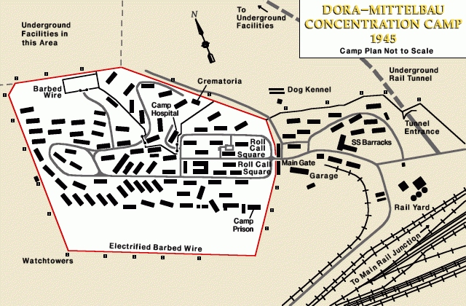
Dora-Mittelbau concentration camp, 1945

Slide 18
Project Paperclip
Fort Bliss, 1946
Group of 104 German rocket scientists in 1946, including Wernher von Braun, Ludwig Roth and Arthur Rudolph, at Fort Bliss, Texas.

