Slide 1
The formation of a transnational diasporic belonging in the Ukrainian Emigration
Simone A. Bellezza
Department of Social Sciences, University of Naples Federico II
@
Danyliw Research Seminar on Contemporary Ukraine
7-9 November 2019
Chair of Ukrainian Studies, University of Ottawa

Slide 2
There is no Ukrainian Diaspora
Criticism towards the concept of “Diaspora” (see Rogers Brubaker).
Ukrainians are skeptical about the existence of one diaspora.
Diaspora still are the product of a specific historical development (not any migration produces a diaspora).

Slide 3
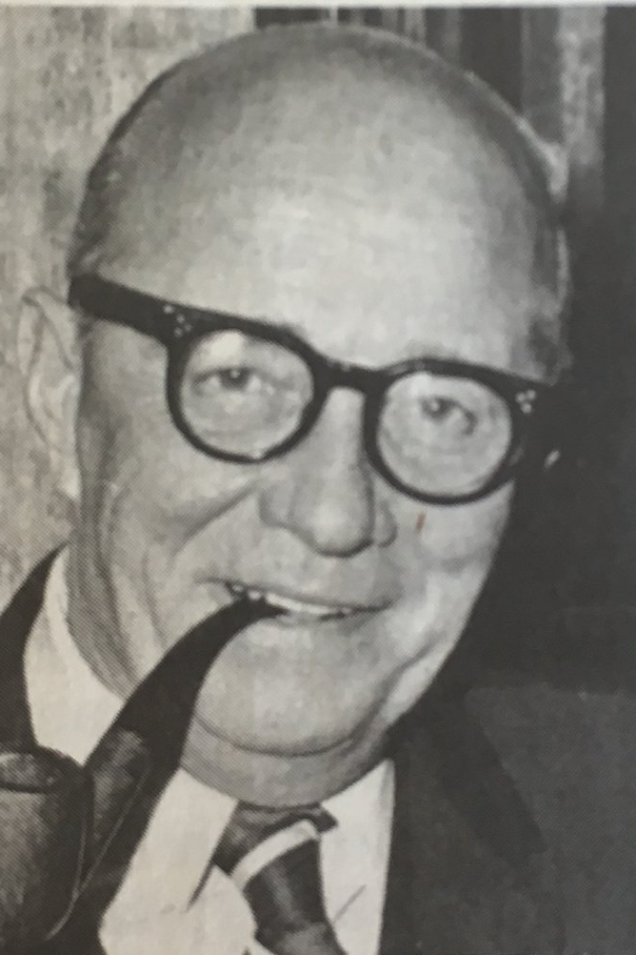
Hyphenated Ukrainians
Lev Dobriansky president of UCCA (1949-1954, 1962-1983).
“Ukrainian Rivulets in the Stream of American Culture” 1947.
The element of mission: Ukrainians in America are counterparts of those in Soviet Ukraine.

Slide 4
Multicultural Ukrainians
Ukrainians in Canada (P. Yuzyk, M. Lupul) significantly contributed to the creation of multiculturalism.
First WCFU in New York 12-19 November 1967.
John Syrnick proposed the rejection of the word “emigration.”
He elaborated the ”Credo” of the Ukrainian in diaspora, based on the idea of multiple national belongings.

Slide 5
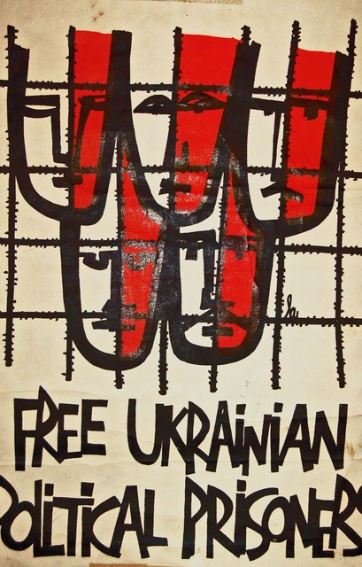
The transnational mission of defending human rights
Example of the New York City Ukrainian Students Hromada and of the Committee to Defend Soviet Political Prisoners.
Personal activism: Amnesty International and other international organization, Christina Isaijw and the centrality of human rights over national rights (women’s rights, feminism etc.).
Second WCFU in Toronto in 1972 put the defense of human rights at the centre of its international political strategy.

Slide 6
Ghetto Ukrainians
Australian Ukrainians tried to reformulate the struggles for the “defense of human rights” and against (neo-) colonialism in such a way as to fit in into their particular political ideas.
Australian Ukrainians have a particular political fade: “extremely” right wing; national rights over individual rights.

Slide 7
A new definition of diaspora?
Diasporas are “viewed as spaces of communication, as ‘contact zones’, as ‘social spaces where cultures meet, clash, and grapple with each other’ […] Far from being an emblem of the unity of a dispersed people with an imagined homeland as point of reference, diasporas thus become […] an expression of fragmentation, of the multiplicity of loyalties and belongings.”

