Slide 1
No Safe Place: Geopolitical and Humanitarian Implications of Medical Care Infrastructure Destruction in the Donbas Conflict
Cynthia Buckley, Ralph Clem, and Erik Herron

Slide 2
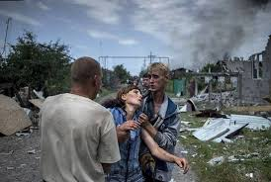
State Capacity and War
Civilian Infrastructure in the Donbas
State capacity as a conceptual framework
Coercive
Extractive
Bureaucratic
State capacity and legitimacy
Our project addresses:
Objective effects: Geolocation/catalogue of infrastructure damage
Perceptions: Blame attribution; media coverage

Slide 3
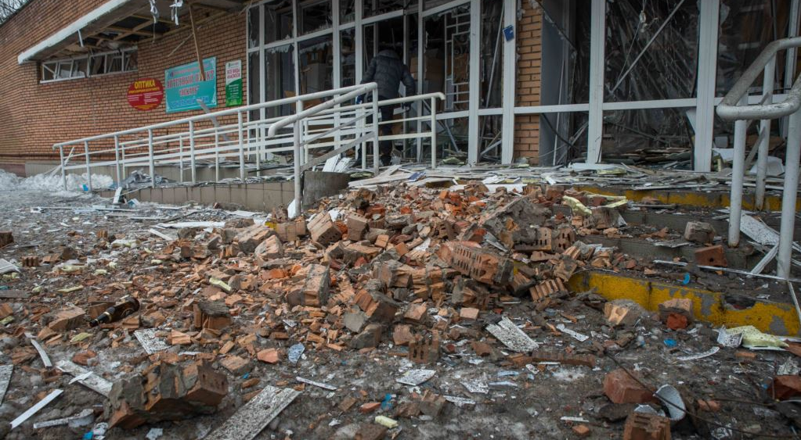
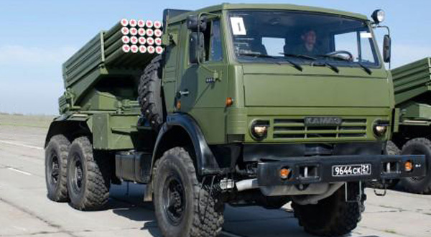
Context and Assumptions
Assessing Medical Care Infrastructure Damage
Hybrid war is an outdated concept.
The Donbas War would not have occurred without Russian intervention.
Medical facilities have been intentionally targeted in international conflicts. In Ukraine, damage has come from both sides, often from area effects weapons.
Medical infrastructure damaged more significantly than previously reported.

Slide 4
Data and Methods
Assessing Medical Care Infrastructure Damage
Sources: Ukrainian and Russian media, international organization and NGO reports, & English sources.
Geo-located 247 registered hospitals and clinics in Donetsk and Luhansk Oblasts.
Cross-checked to ensure precise identification.
Shelling reported quarterly to avoid duplication.
One-third (92) hospitals/clinics damaged. WHO estimated 150.

Slide 5
Unsafe Places: Attacks on Hospitals, 2014-18

Slide 6
Unsafe Places: Attacks on Hospitals, 2014-18

Slide 7
Attacks on Hospitals, Sloviansk
“Insurgent” forces occupied some medical facilities; not the Liman Railway Hospital.
Ukrainian forces attacked 3/5 hospitals in Sloviansk.
Kramatorsk hospital attacked by “insurgent” and/or Russian forces.

Slide 8
Attacks on Hospitals, Mariupol
Eight medical facilities attacked from 2014-16.
Indirect evidence implicates “insurgent”/Russian forces.

Slide 9
Attacks on Education
The Donbas War has affected other civilian infrastructure.
Developing catalogue of attacks on schools.

Slide 10
Closed Polling Places
The Donbas War has affected other civilian infrastructure.
Many polling places (including schools and hospitals) were unavailable for the 2014 parliamentary elections. Assessing effects on election administration.

Slide 11
Conclusions
Need to understand the implications of the Donbas War
Our project emphasizes state capacity, especially the provision of services to civilians.
Our first step is cataloguing damage, assessing responsibility, and evaluating reporting on health care infrastructure.
Our next steps will expand the analysis to education and elections.

