Slide 1
Cold War and the Fate of Ukrainian Culture
Markian Dobczansky
Visiting Scholar
Harriman Institute, Columbia University
markian.dobczansky@gmail.com

Slide 2
Outline
Cold War Historiography
Shevchenko Statues (1960–1964)
Russification Controversy (late 1960s)
The Ukrainian Cold War and the Fate of Ukrainian Culture

Slide 3
Cold War Historiography
Convergent/divergent approaches
Brings Ukraine back
Addresses certain blind spots

Slide 4
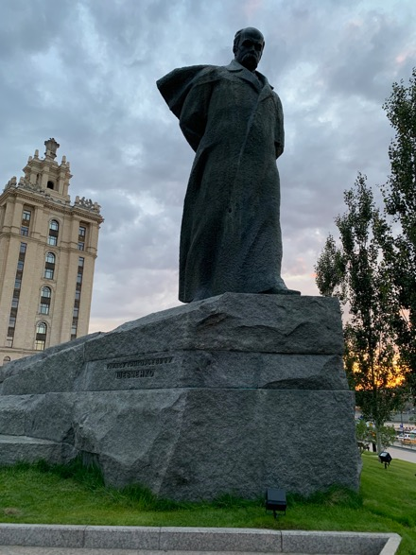
Shevchenko Statues
Washington, D.C.
Moscow

Slide 5
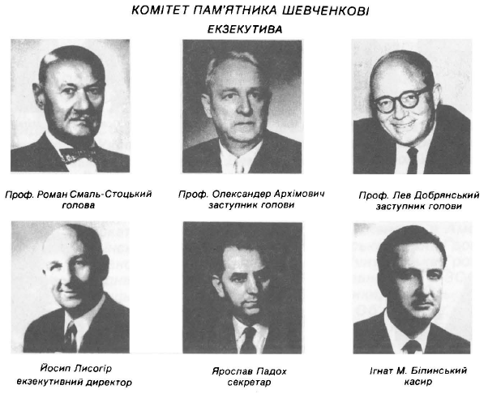
Statue in Washington, D.C.
Act of Congress in 1960
Shevchenko Memorial Committee formed

Slide 6
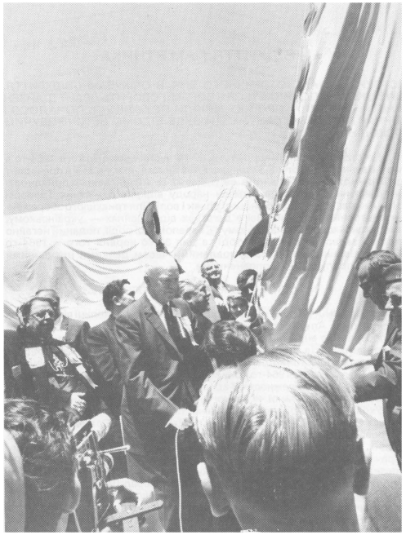
Statue in Washington, D.C.
Groundbreaking 1963
Unveiling of Statue June 27, 1964
Former president Eisenhower spoke
40K—100K attended
Soviet diplomats do not attend

Slide 7
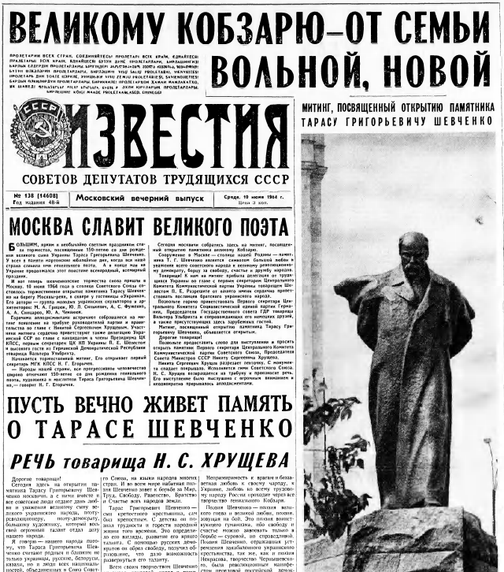
Statue in Moscow
Near Hotel Ukraina
Unveiled June 10, 1964
Khrushchev gave speech

Slide 8
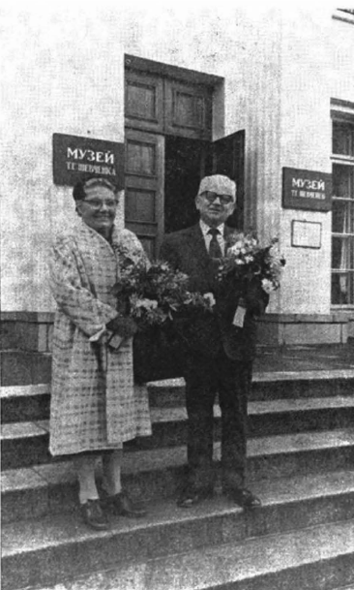
Shevchenko Statues
Platon Stasiuk and the Parcel of Land from Shevchenko’s Grave

Slide 9
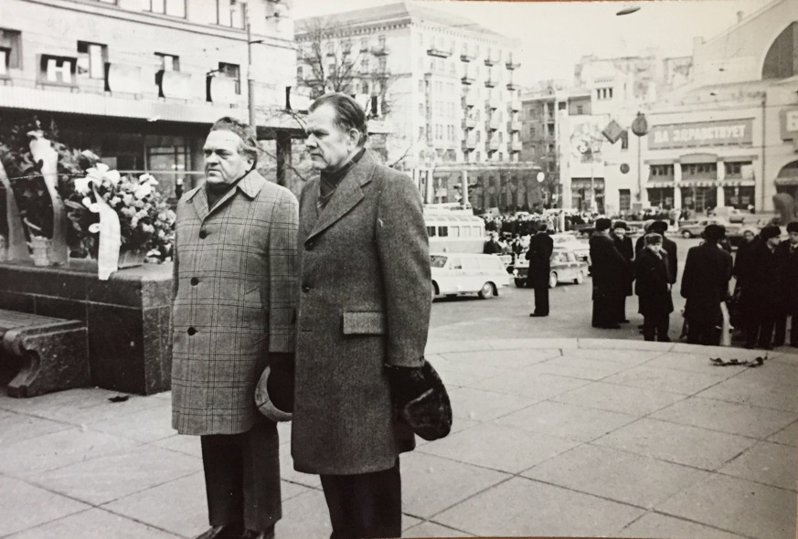
Russification Controversy
Communist Party of Canada
Association of United Ukrainian Canadians
Society for Cultural Relations with Ukrainians Abroad

Slide 10
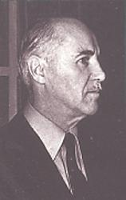
Russification Controversy
John Kolasky (1915–1997)

Slide 11
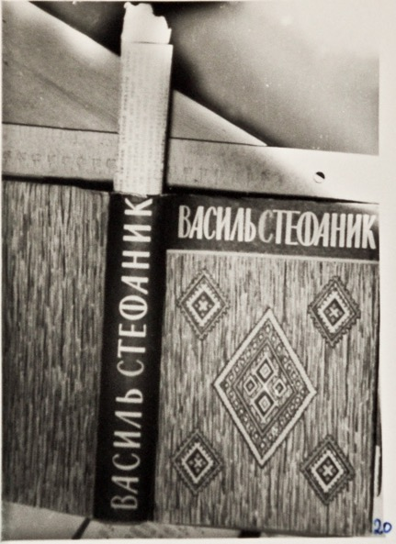
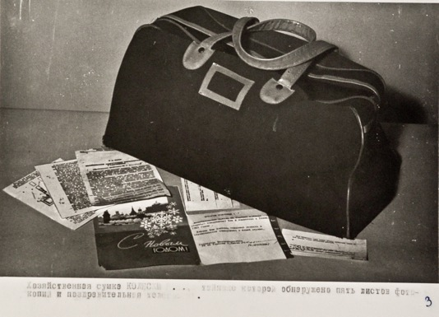
Russification Controversy
Kolasky’s seized belongings

Slide 12
Soviet Image of Shevchenko

Slide 13
Cold War and the Fate of Ukrainian Culture
Thank you for your attention!
Markian Dobczansky
Visiting Scholar
Harriman Institute, Columbia University
markian.dobczansky@gmail.com

