Slide 1
To Risk One’s Life for Another: The Moral Psychology of Rescuing Jews during the Holocaust in Occupied Ukraine
Raisa Ostapenko, PhD Candidate, Sorbonne University

Slide 2
Visualization

Slide 3
Arguments

Slide 4
The altruistic personality

Slide 5
“The Banality of Good.”

Slide 6
A categorical imperative through relativist means: A case for Kantian consequentialism?

Slide 7
On moral identity & the integration of values

Slide 8
“Rehumanization”

Slide 9
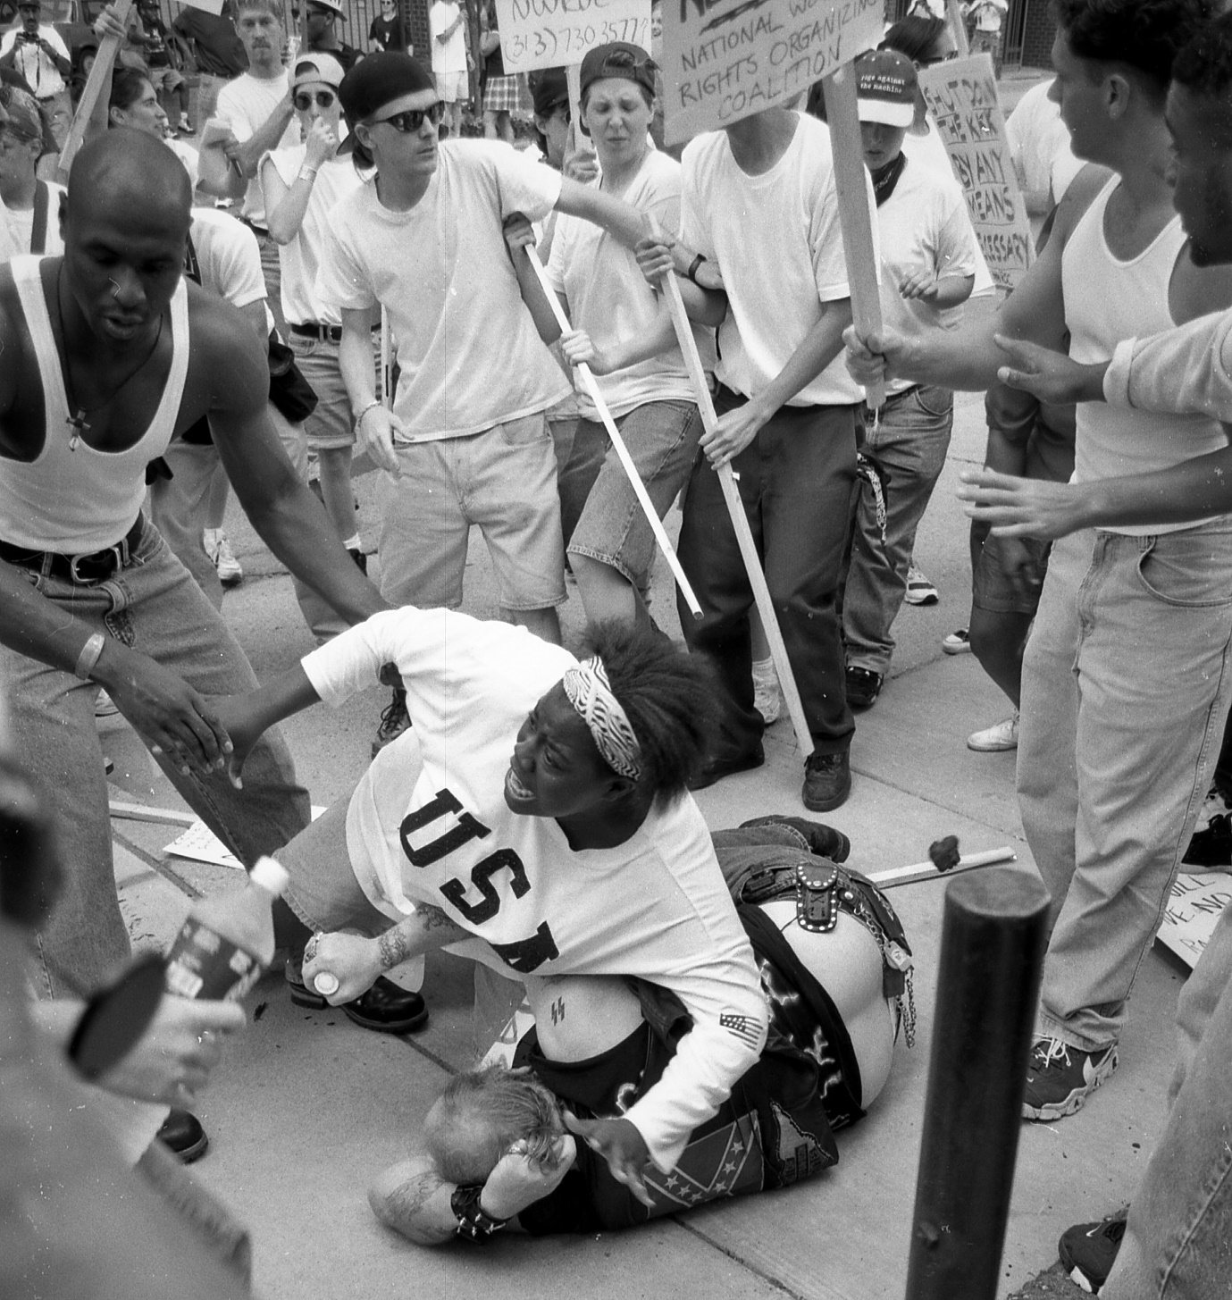
Then eighteen-year-old Keshia Thomas shielding a white supremacist with her body from an angry mob. Ann Arbor, Michigan. June 22, 1996. Photographer: Mark Brunner.

