Slide 1
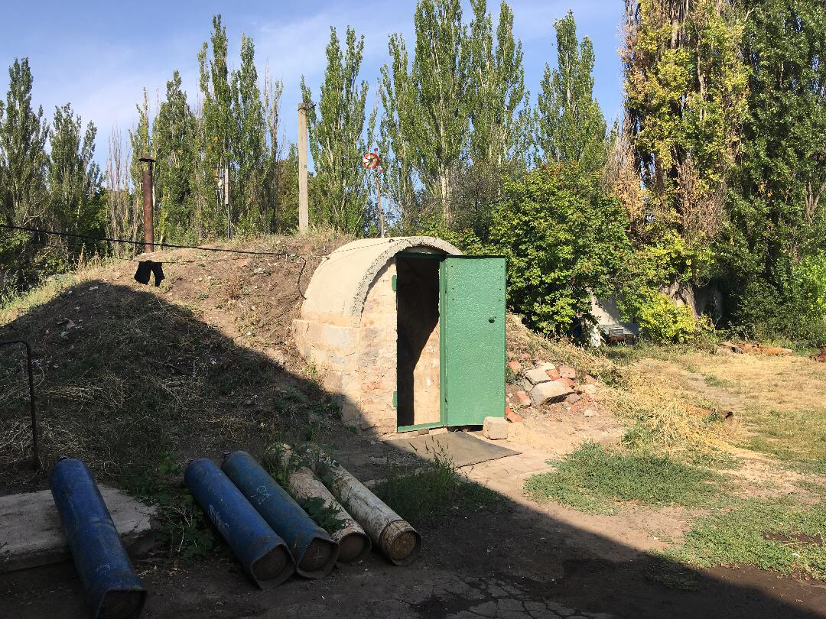
Providing water across “enemy” lines: how Voda Donbasu adapts to the warscape in eastern Ukraine
-Sophie Lambroschini,
postdoc fellow & associate researcher
Centre Marc Bloch, Berlin

Slide 2
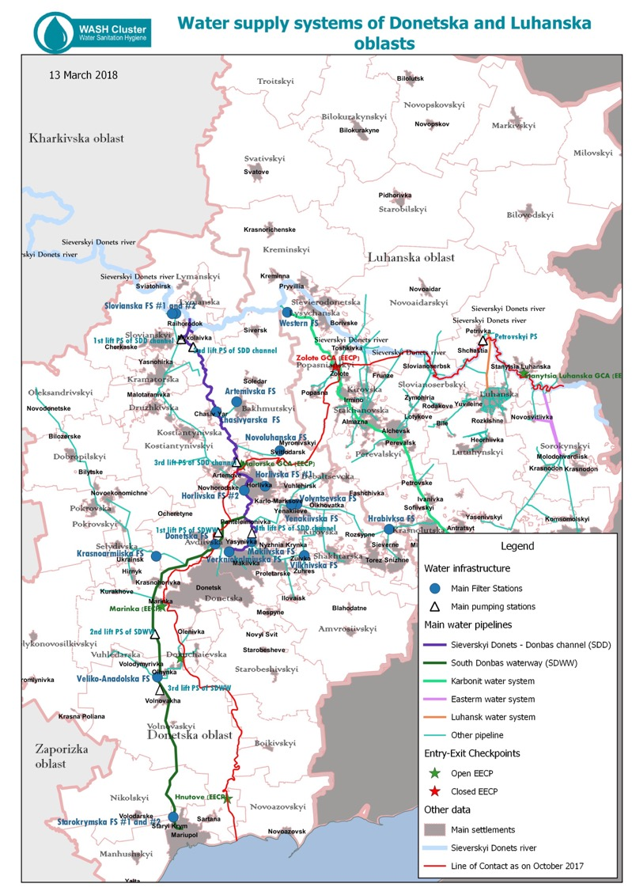
The water distribution system in Western Donbas

Slide 3
Buying drinking water in Toretsk
Voda Donbasu Pumping station in Toretsk, Donetsk obl.

Slide 4
Voda Donbasu, operating across the front line (1)
Cross-border infrastructure and management
12000 people workforce on both sides of the contact line

Slide 5
Voda Donbasu, operating across the front line (2)
Direct and indirect damage due to war : casualties, shelling, loss of revenue and maintenance.
Necessary inclusion and interaction with government, military and international actors

Slide 6
Research question
How do the social and operational dynamics of infrastructure adapt to violent conflict?
Notes:
– defined by C. Nordstrom as the specific context created by low-intensity conflicts and characterized by blurred borders

Slide 7
Introduction
Olha’s experience adapting to working in her old job in a new context. Highlighting forms of occupational adaptation to war.

Slide 8
Methodology
Anthropological approach
Men and their work at Voda Donbasu: interviews and participant-observation

Slide 9
Conceptual framework: interactionist sociology and anthropology of war
explain how work in a new and dangerous environment gains meaning through social interactions (Hughes 1998, Becker 1986)
adapting to conflict-provoked system collapse by “negotiating normality” (Maček 2007)
in a specific social context marked by danger and violence (“warscape”, Nordstrom 1997)

Slide 10
Working “normally” in war (strategies 1)
Seeking normalization through evasion
➠ sticking to old work-routines
Notes:
Facing danger as a mission: a new professional legitimization
Occupational mission as rationalization for “remaining”
Depoliticization of intra-corporate relations

Slide 11
Working "normally" in war (strategies 2)
Seeking normalization through innovation
➠ adapting former practices to the warscape
Notes:
Facing danger as a mission: a new professional legitimization
Occupational mission as rationalization for “remaining”
Depoliticization of intra-corporate relations

Slide 12
Working “normally” in war (strategies 3)
Seeking normalization through new work legitimacy
➠ integrating conflict&risk as a mission
Notes:
Facing danger as a mission: a new professional legitimization
Occupational mission as rationalization for “remaining”
Depoliticization of intra-corporate relations

Slide 13
Everyday work in war: Reframing occupational legitimacy and identity
Danger as new professional legitimization
“Mission” as rationalization for “remaining”
Depoliticization of intra-corporate relations
Front line as a complication to be managed

