Slide 1
The role of grain procurement
in understanding regional variations of
1933 Holodomor losses
Nataliia Levchuk
Ptoukha Institute of Demography and Social Studies, Kyiv
Danyliw Research Seminar
Ottawa, 8-10 October, 2018

Slide 2
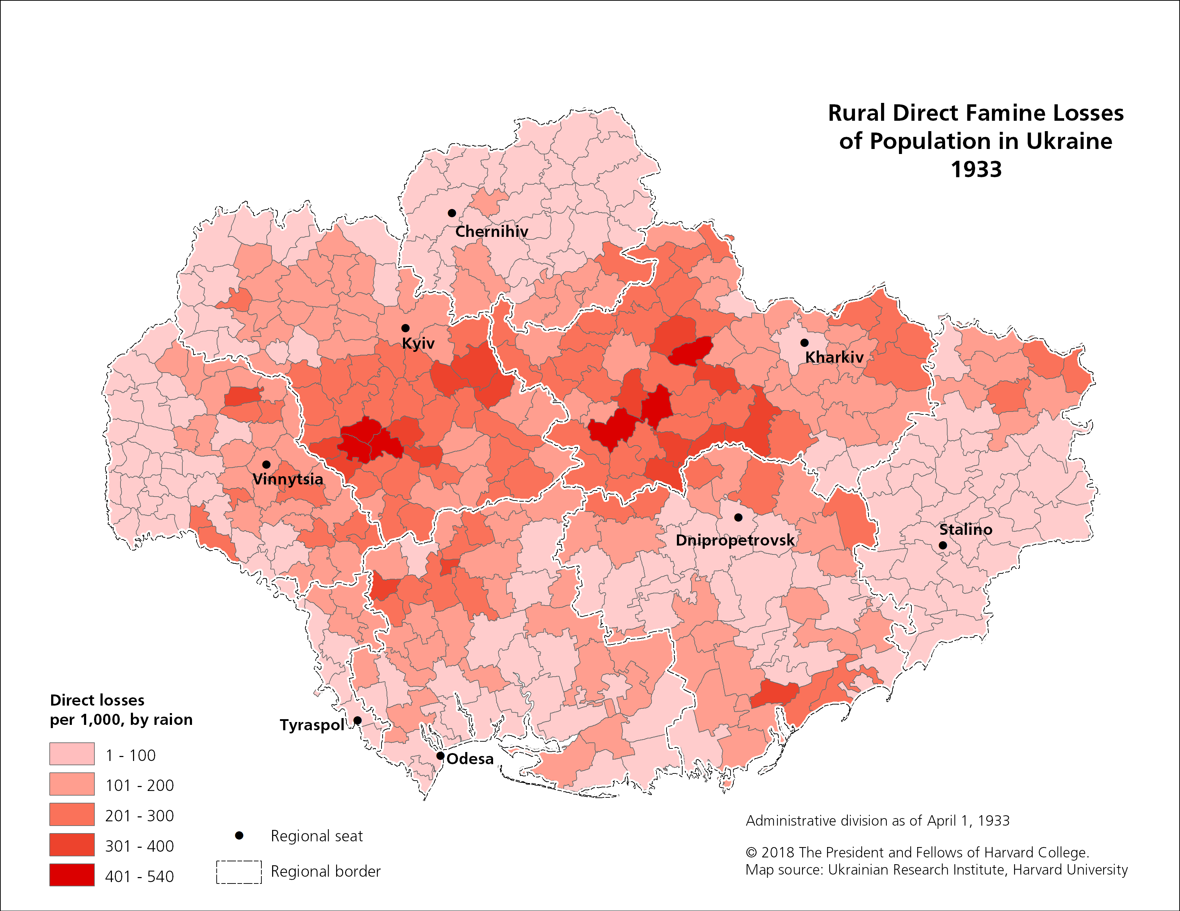
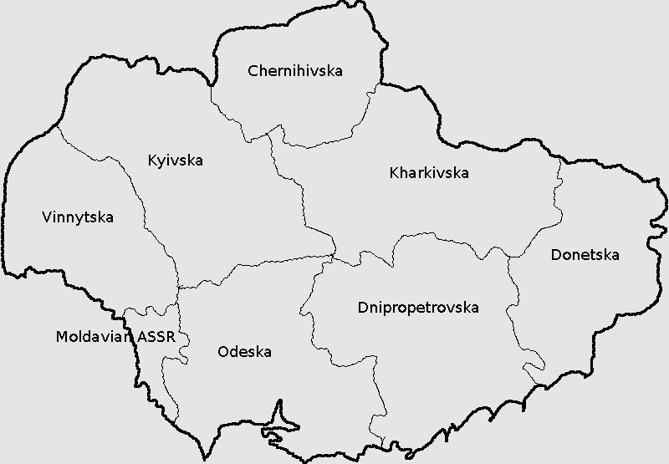
1933 DIRECT FAMINE LOSSES: 391 raions
The highest excess deaths are mostly found in the forest-steppe raions of central Ukraine

Slide 3
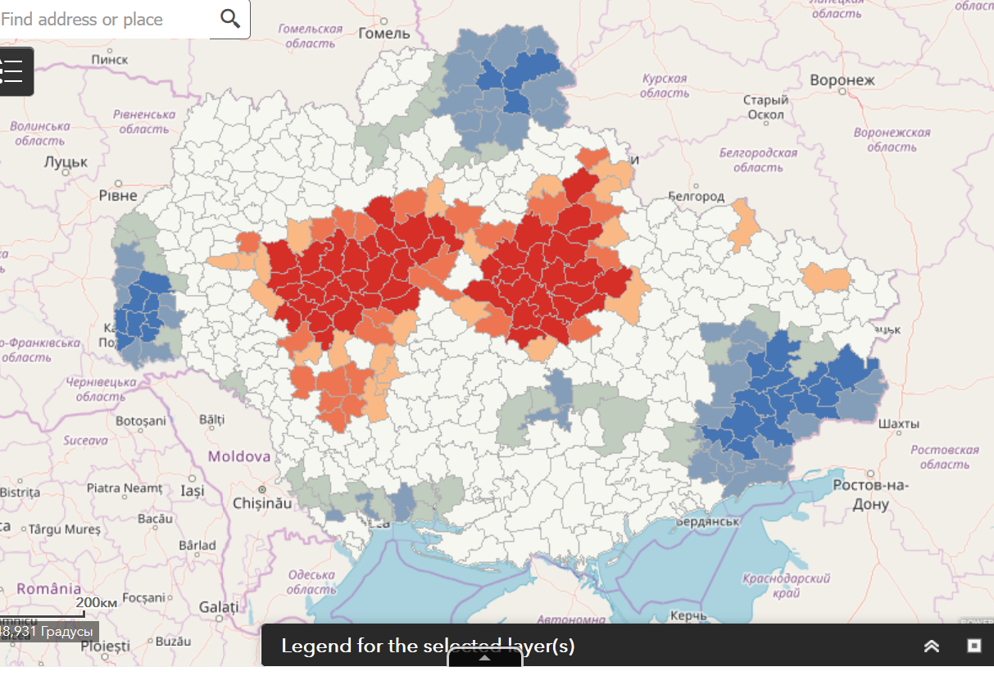
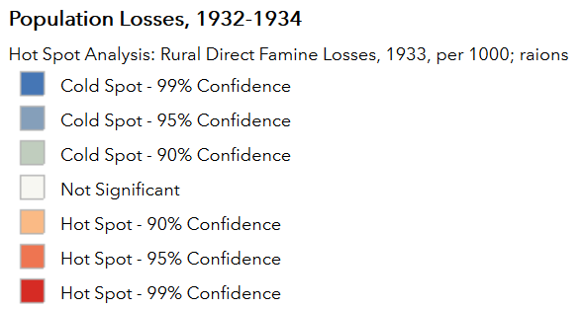
HOT SPOT ANALYSIS
.
Hot spots (clusters of highest mortality): Kyiv, Kharkiv and partly Vinnytsia oblasts.
Cold spots (clusters of low mortality) : Chernihiv, Donetsk and Vinnytsia oblasts.

Slide 4
The role of grain procurements:
two perspectives
.
The scale and intensity of the 1932-33 Famine were determined exclusively by grain procurements. The number of losses due to the Famine is associated with the amount of grain confiscated by state and the contribution of a region to the total grain collection.
The grain procurement factor played an important role in the Famine of early and mid-1932 but since the late 1932 and in 1933 the situation changed. Holodomor was not an accident resulted from grain procurements but a politically engineered attack to suppress Ukrainian nationalism and peasant opposition.

Slide 5
Objective and research question
.
Objective:
to examine the role of grain procurements and other possible determinants of regional differences in the 1933 Holodomor losses within Ukraine
Research question:
What factors may have contributed to regional variations in 1933 excess mortality?
H: the regional differences in Famine-induced mortality are explained by the grain procurements.

Slide 6
DATA
Variable | Range (min-max) | Mean | Obs.
Outcome variable
1933 rural excess deaths, by raion | 0.001- 0.540 | 0.145 | 391
Explanatory variables, level 1 (raion)
Density of rural population Jan. 1st , 1933 | 0.14 – 1.159 | 0.604 | 391
% Ukrainians, 1926 | 0.015 -0.996 | 0.846 | 391
% collectivization, Oct.-Dec. 1932 | 0.157 – 1.000 | 0.713 | 391
Planned grain procurements, 1931 relative to 1930 | 0.070 – 7.000 | 1.345 | 374
Planned grain procurements, 1932 relative to1930 | 0.060 – 3.150 | 0.681 | 374
1930 grain procurement plan per capita, tons | 0.005 – 1.479 | 0.303 | 372
1931 grain procurement plan per capita, tons | 0.003 – 1.455 | 0.314 | 373
1932 grain procurement plan per capita, tons | 0.007 – 1.114 | 0.209 | 386

Slide 7
DATA
Variable | Range (min-max) | Mean | Obs.
1930 actual grain procurements per capita, tons | 0.006 – 1.647 | 0.295 | 384
1931 actual grain procurements per capita, tons | 0.006 – 1.371 | 0.285 | 384
1932 actual grain procurements per capita, tons | 0.008 – 0.913 | 0.170 | 386
Fulfillment of 1930 grain procurement plan | 0.633 – 1.888 | 1.013 | 373
Fulfillment of 1931 grain procurement plan | 0.579 – 2.010 | 0.947 | 373
Fulfillment of 1932 grain procurement plan | 0.218 – 1.170 | 0.894 | 386
Crop area used for wheat, 1932 | 0.001 -0.520 | 0.223 | 386
Wheat crop area for independent farmers, 1932 | 0.000 -0.815 | 0.183 | 386
Wheat crop area for collective farms, 1932 | 0.179 – 0.998 | 0.727 | 386
Wheat crop area for state farms, 1932 | 0.000 – 0.805 | 0.089 | 386
Black board index | 0.000 – 1.000 | 0.500 | 391
Distance from the raion center to the nearest railway station, ln | 0.000 – 4.718 | 2.468 | 325

Slide 8
DATA
Variable | Range (min-max) | Mean | Obs.
Level 2 variables (oblast)
ID of region (oblast) | 1 - 8 | 4.5 | 391
Rail network density per km² ,1928 | 0.024 -0.046 | 0.031 | 391
Terror acts per 1,000 peasants, October 1931-March 1932 | 0.028 – 0.091 | 0.051 | 355
Fines in kind per 1,000 peasants, December 1932 | 0.008 – 0.557 | 0.194 | 391
Brigades requisitioning grain from independent farmers per 1,000 peasants, December 1932 | 0.019 – 0.084 | 0.047 | 331
Persons arrested for sabotage and resistance to grain procurements per 1,000 peasants, January 11 1933 | 0.492 – 1.221 | 0.774 | 391

Slide 9
Dynamics of grain procurement quotas: Ukraine
 | 1930 | 1931 | 1932
Planned procurements, compared to previous year | Higher | +9% | -35% (final plan)
Actual procurements, compared to previous year | Higher | Almost the same | -45%
Actual/planned: % fulfillment | 100% | 91% | 61% of initial plan 95% of final plan

Slide 10
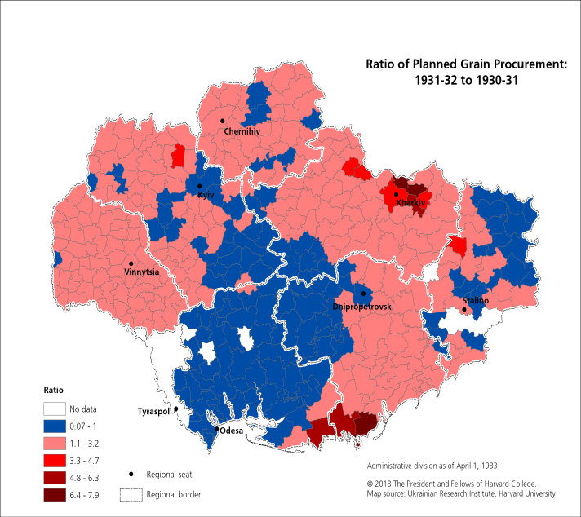
Dynamics of planned procurement quotas: raion-level
Planned quotas:
1931 relative to 1930
Increase in quotas - in red
Decrease in quotas - in blue

Slide 11
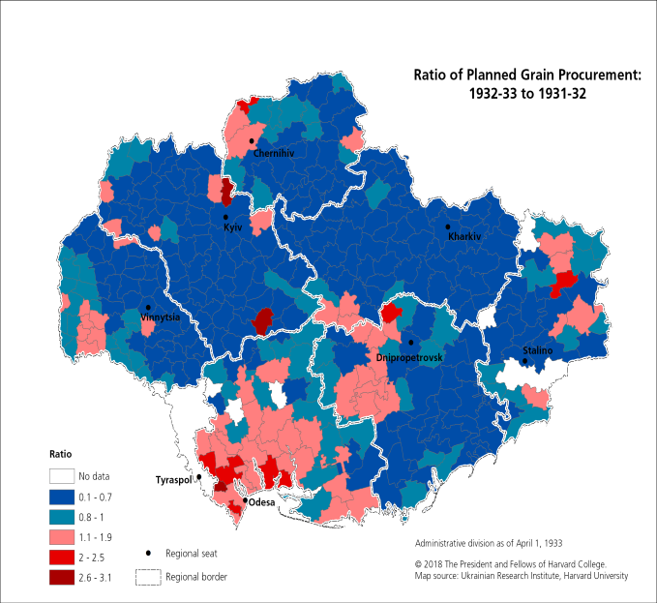
Dynamics of planned procurement quotas: raion-level
Planned quotas:
1931 relative to 1930
Planned quotas:
1932 relative to 1931
Increase in quotas - in red
Decrease in quotas - in blue

Slide 12
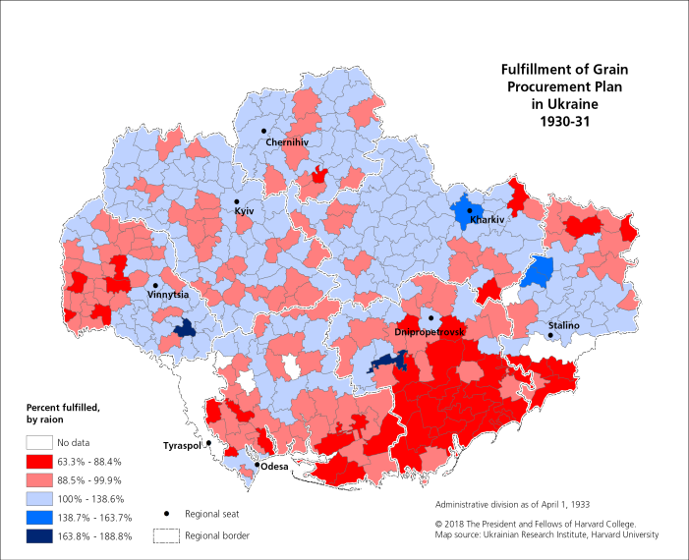
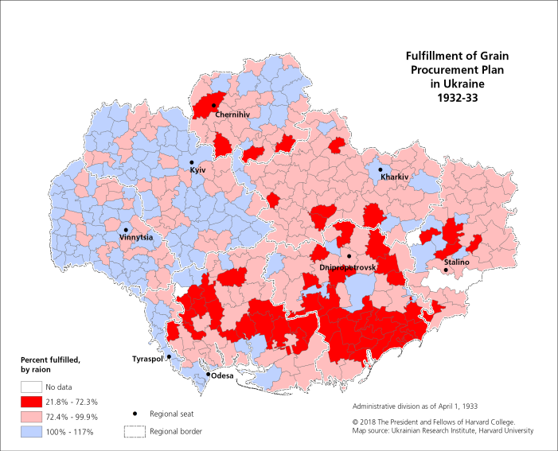
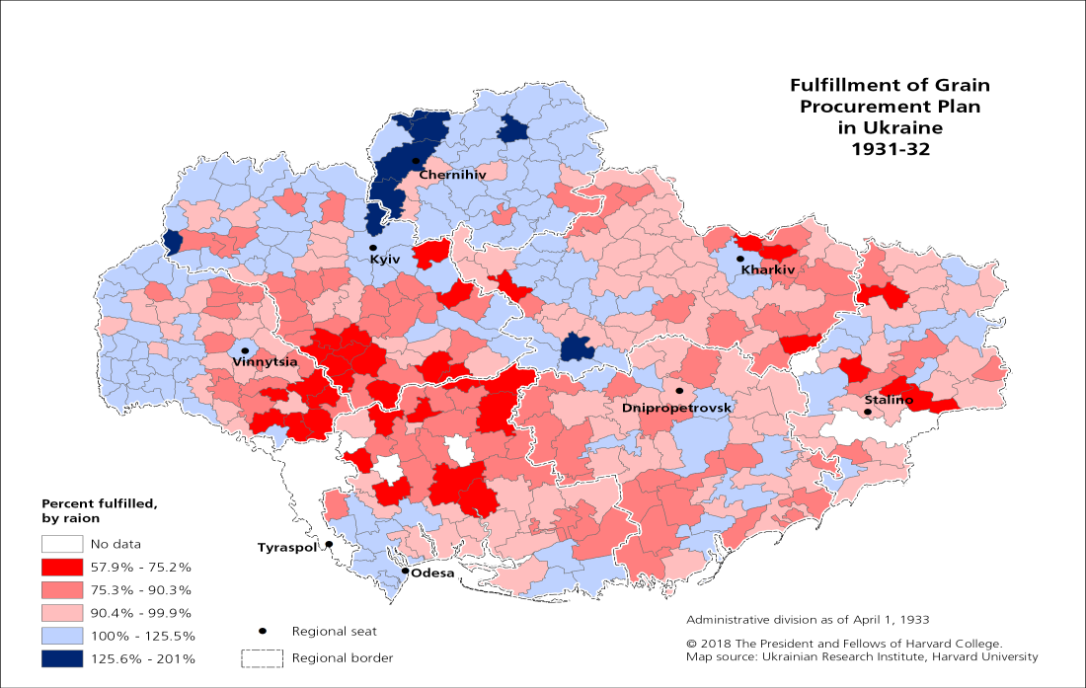
Fulfillment of planned quotas: raion-level
1930
1932
1931
Not fulfilled – in red
Fulfilled – in blue

Slide 13
Multilevel model
Two-level structure:
Level 1: raion, n=391
Level 2: oblast, n=8
Dependent variable: excess deaths in 1933
‘Empty’ two-level model (without explanatory variables with fixed intercept)
Random intercept model with explanatory variables

Slide 14
Multilevel model
Variables significantly associated with 1933 excess mortality:
Proportion of Ukrainians
Collectivization
Proportion of land used for wheat
1931 actual grain procurements
Fulfillment of 1931 grain procurement plan
1932 actual grain procurements
Fines in kind

Slide 15
Multilevel model
 | Coef.
Dependent variable – 1933 excess deaths
Raion-level variables
Ukrainians | 0.106***
Collectivization* | 0.099**
Crop area used for wheat | 0.236***
1931 actual grain procurements per capita | 0.007*
Fulfillment of 1931 grain procurement plan | -0.154***
1932 actual grain procurements per capita | -0.256***
Oblast-level variables
Fines in kind (food fines) | 0.172**
% of variance in 1933 excess deaths explained by differences between oblasts:
27.3% in ‘empty’ model
9.5% in final model
Our variables explain 41% of the original variance in 1933 excess mortality

Slide 16
Thank you!

