Slide 1
Gender in Crisis: Women and ‘Crimean Solidarity’
Elmira Muratova, PhD
Crimean Federal University
Simferopol, Crimea

Slide 2
Research on women in conflict
Women as victims of conflict.
Women as agents, active participants as fighters or supporters of conflicting sides.
Change in gender roles during the conflict.
Women empowerment, increase of their role in decision-making.
Little research on women empowerment under occupation and state terror.

Slide 3
The aim and focus of the paper
The aim: to show the changes in gender roles in Crimean Tatar society under the influence of the 2014 annexation of Crimea and the ensuing politically and religiously motivated repression of certain groups of Crimean Tatars.
The focus: women of Crimean Solidarity (CS) – mothers and wives of arrested men, human rights defenders, journalists, and activists.
- established in April 2016.
- based on the Party of Islamic Liberation (Hizb ut-tahrir) (HT) group.
- has a hybrid structure and discourse (Islamic & secular/ethnic).

Slide 4
Gender roles change after 2014
Traditional gender roles among the members of HT.
The change of lives of many women of CS.
Personal changes (character, attitudes).
The need for decision-making and caring responsibility for it.
The issue of women’s employment (part-time and full time jobs).

Slide 5
Muslim women activism in Crimea
Three main areas of activities – human rights, information, and education.
New horizons both in personal and professional development.
Personal growth (intellectual development, continuing education, acquisition of professional skills).
Sense of insecurity, guilt for not paying much attention to own families.
Internal family discussions about insecurity.
Attempts to influence decision-making process in the CS.

Slide 6
Concluding Remarks
Gender theorist Judith Butler on Palestinian women (2010):
“It seemed that if you were subjugated, there were also forms of agency that were available to you, and you were not just a victim, or you were not only oppressed, but oppression could become the condition of your agency. Certain kinds of unexpected results can emerge from the situation of oppression if you have the resources and if you have the collective support.”
Muslim women agency in Crimea as unexpected result :
- need for self-development, personal growth;
- due to the lack of human resources within CS;
- within the framework of Islamic traditions (clothes, meetings, etc.);
- uncertainty of further development.

Slide 7
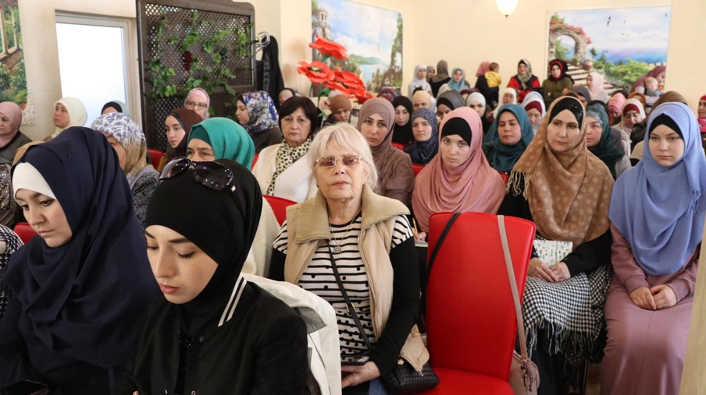
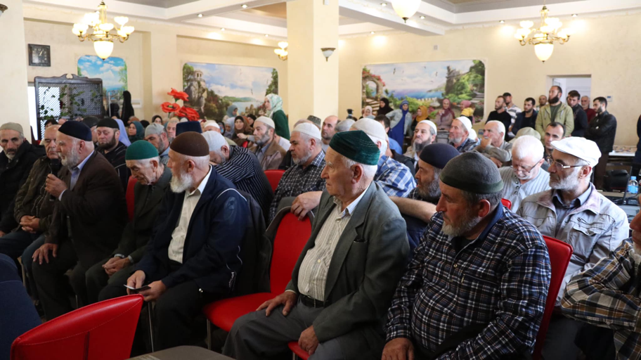

Slide 8
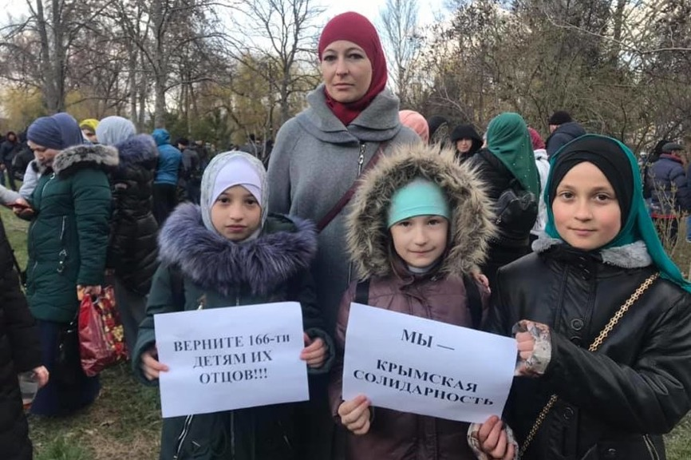
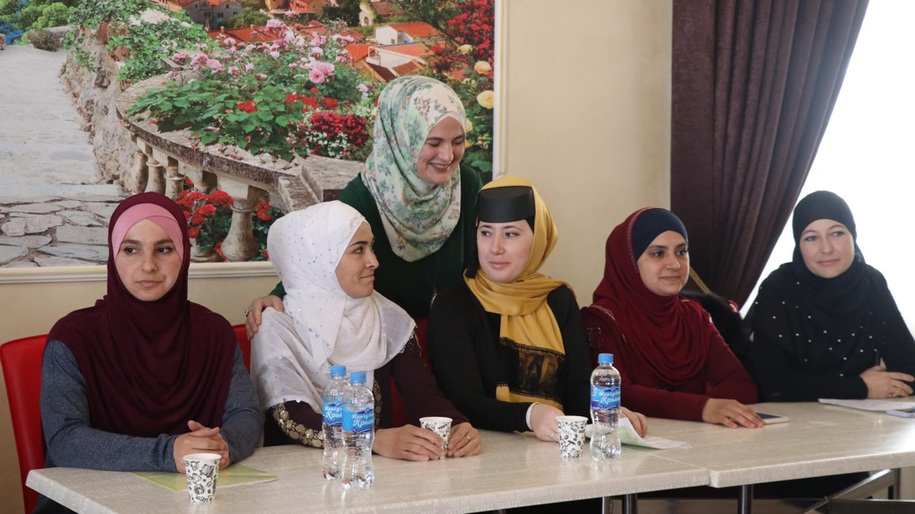

Slide 9
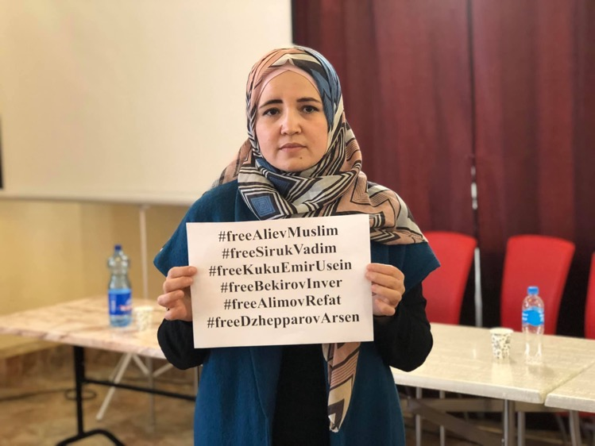
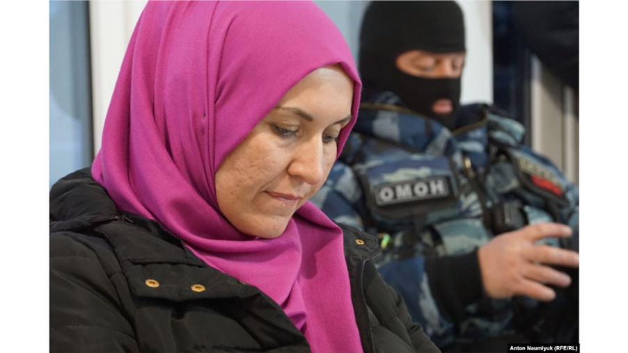
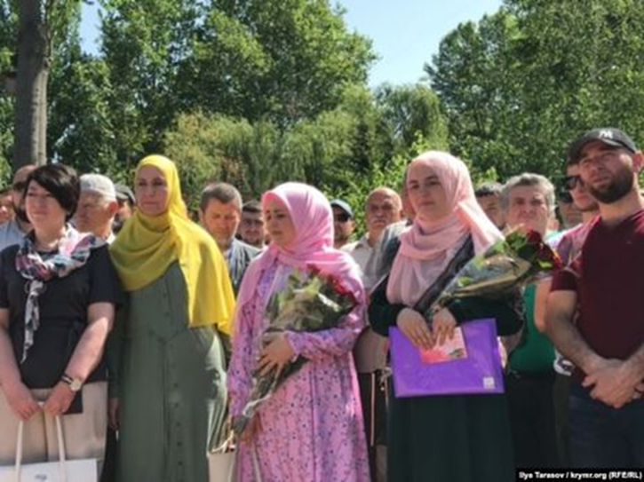

Slide 10
