Slide 1
Corruption Risks in Defence Procurement in Ukraine
This research is co-authored by Eva Anderson and Dmytro Khutkyy and was conducted for NAKO, a joint project by Transparency International Defence & Security and Transparency International Ukraine

Slide 2
Introduction
The Ministry of Defence budget exceeds 2.8 billion EUR
Of its procurement budget, 55% is classified
Of armament and military equipment budget, 95% is classified
Systemic interventions are required to reduce these risks
For this aim, we held this study employing 35 well-placed sources
47 incidences of alleged or proven corruption were analysed
As a result, 6 most prevalent challenges were identified

Slide 3
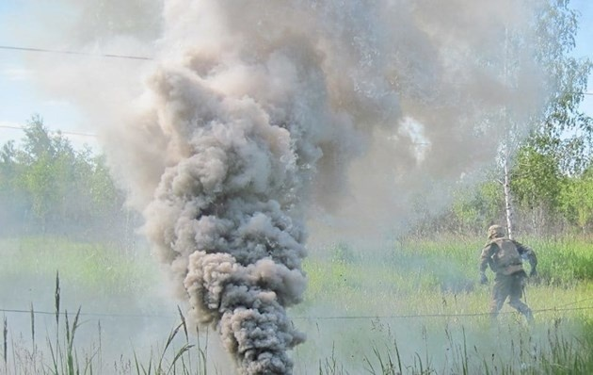
Competition can be deliberately constrained
Specific warning signs:
1. High number of contract awards can be awarded to one bidder
2. Fewer than expected bidders applied to an openly advertised tender
3. The window for bidding can be unreasonably short
4. The ministry can renegotiate for more favourable terms (“low-balling”)
5. Bidders or bids that appear legitimate can be set aside, for unclear or no given justification
6. The MoD can award the contract on a single source basis
7. Two or more competing suppliers can win contracts in a repetitive order (“bid rotation”)
8. Companies can submit bids, withdraw from the competition, and leave one remaining bidder
9. The winning supplier can provide benefits to a losing bidder after the award takes place
Possible case:
A ‘smoking gun’? (2015-2017)
Notes:
3

Slide 4
An official can intervene in the award process to unjustifiably favour a particular company
Specific warning signs:
1. An official can take irregular or unreasonable steps to ensure company’s participation
2. A company can be granted a contract directly, without engaging in a competitive process
3. An official can take unusual steps, for example by narrowing the technical specifications
4. An official can give a winning or competing company information to craft its bid
5. An official with final or high-level decision-making authority can override the outcome
6. The conduct of the award process can exhibit a high or unusual degree of secrecy
7. An official with influence over the award can suggest a sub-contract (“forced marriage”)
Possible case:
Talanlehprom’s Boots (2016)
Notes:
4

Slide 5
The winning bidder can have a shareholder or other business relationship with a politically exposed person
Specific warning signs:
1. The PEP may fail to disclose conflicts of interest and/or fail to recuse from the selection process
2. A PEP may be a legal shareholder or a sub-contractor, or have other individual ties
3. The supplier’s shareholder structure may include a chain or network of shell companies
4. The supplier may engage a PEP or his/her firm as a consultant or service provider
5. The PEP may be able to exert influence over decisions at multiple points in the selection process
6. A PEP or his/her company may provide the supplier with a debt instrument
Possible cases:
Bogdan Corporation’s network of PEPs (2015-2018)
Notes:
5

Slide 6
The MoD can allow an unqualified or hostile state supplier to win a contract
Specific warning signs:
1. The supplier might not meet the ministry’s pre-qualification standards
2. The supplier and/or its principals may have no prior relevant work experience or reputation
3. The company may have been set up specifically for the contract
4. The company might not have the basic capabilities or assets needed to contribute
5. The supplier might not show other basic attributes of a functioning businesses
Possible case:
AV-Pharma’s deadly tourniquets (2015)
Notes:
6

Slide 7
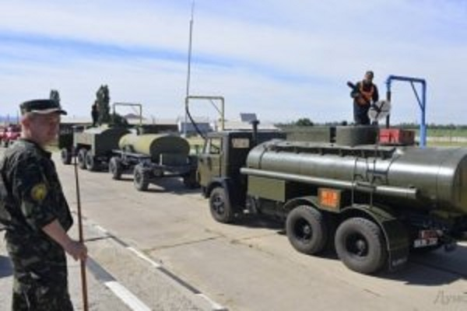
The agreed terms of the award can deviate significantly from industry or market norms
Specific warning signs:
1. The final terms can include prices that are substantially lower or higher than market price
2. The terms or prices of the final award or amended contract can favour the company
3. One or more terms of the contract can be changed only shortly before signing
4. The responsible defence agency can make no effort to assess the market value of the contract
5. The winner’s bid can be substantially higher or lower than ministry’s own assessed value
6. The final award can show significant deviations from existing law or regulation
7. The final terms can include non-standard provisions to favour the winner
Possible case:
Trade Commodity’s winning style (2016)
Notes:
7

Slide 8
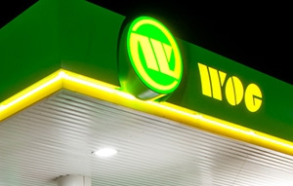
A company with a history of anti-competitive behaviour can win an award
Specific warning signs
1) Under suspicion, investigation or indictment for anti-competitive practices or criminal activity
2) Convicted of criminal activity or violations of other relevant laws
3) A record of failing to perform contractual obligations or other adverse legal activity that suggests unethical business practices
Possible case:
Wog Aero Jet’s anti-competitive practices (2016)
Notes:
8

Slide 9
Six ‘red flags’
Competition can be deliberately constrained
An official can intervene in the award process to unjustifiably favour a particular company
The winning bidder can have a shareholder or other business relationship with a politically exposed person (PEP)
The MoD can allow an unqualified or hostile state supplier to win a contract
The agreed terms of the award can deviate significantly from industry or market norms
A company with a history of anti-competitive behaviour can win an award

