Slide 1
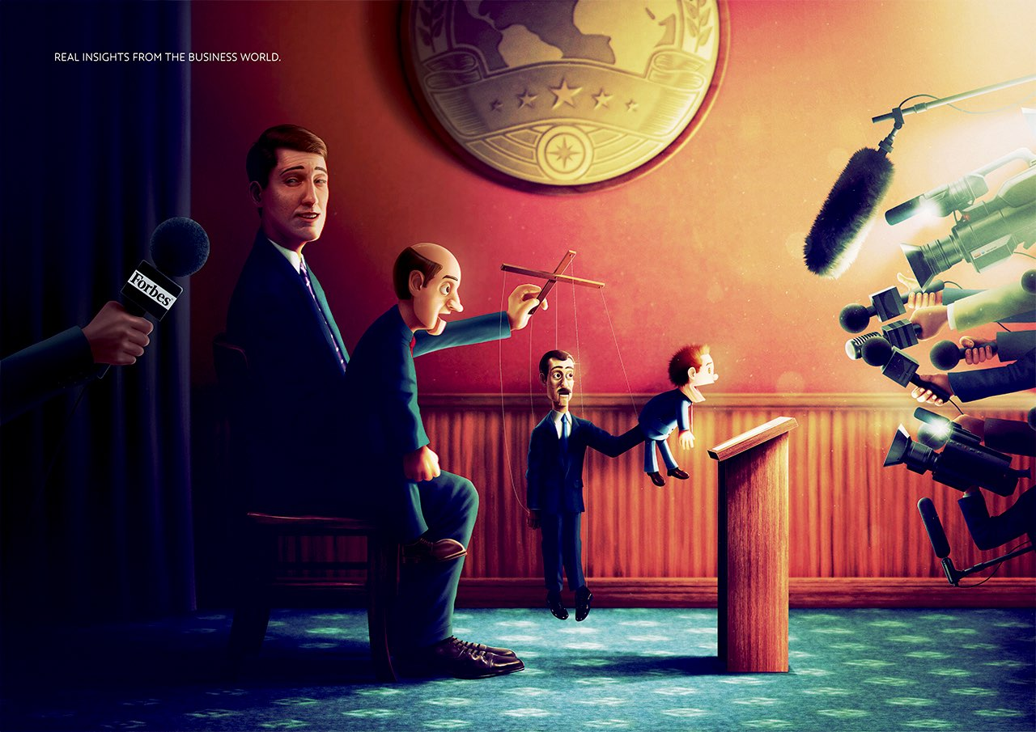
Money and free speech in Ukrainian political journalism:
the case of Hromadske
Taras Fedirko
University of Cambridge
Source: Forbes

Slide 2
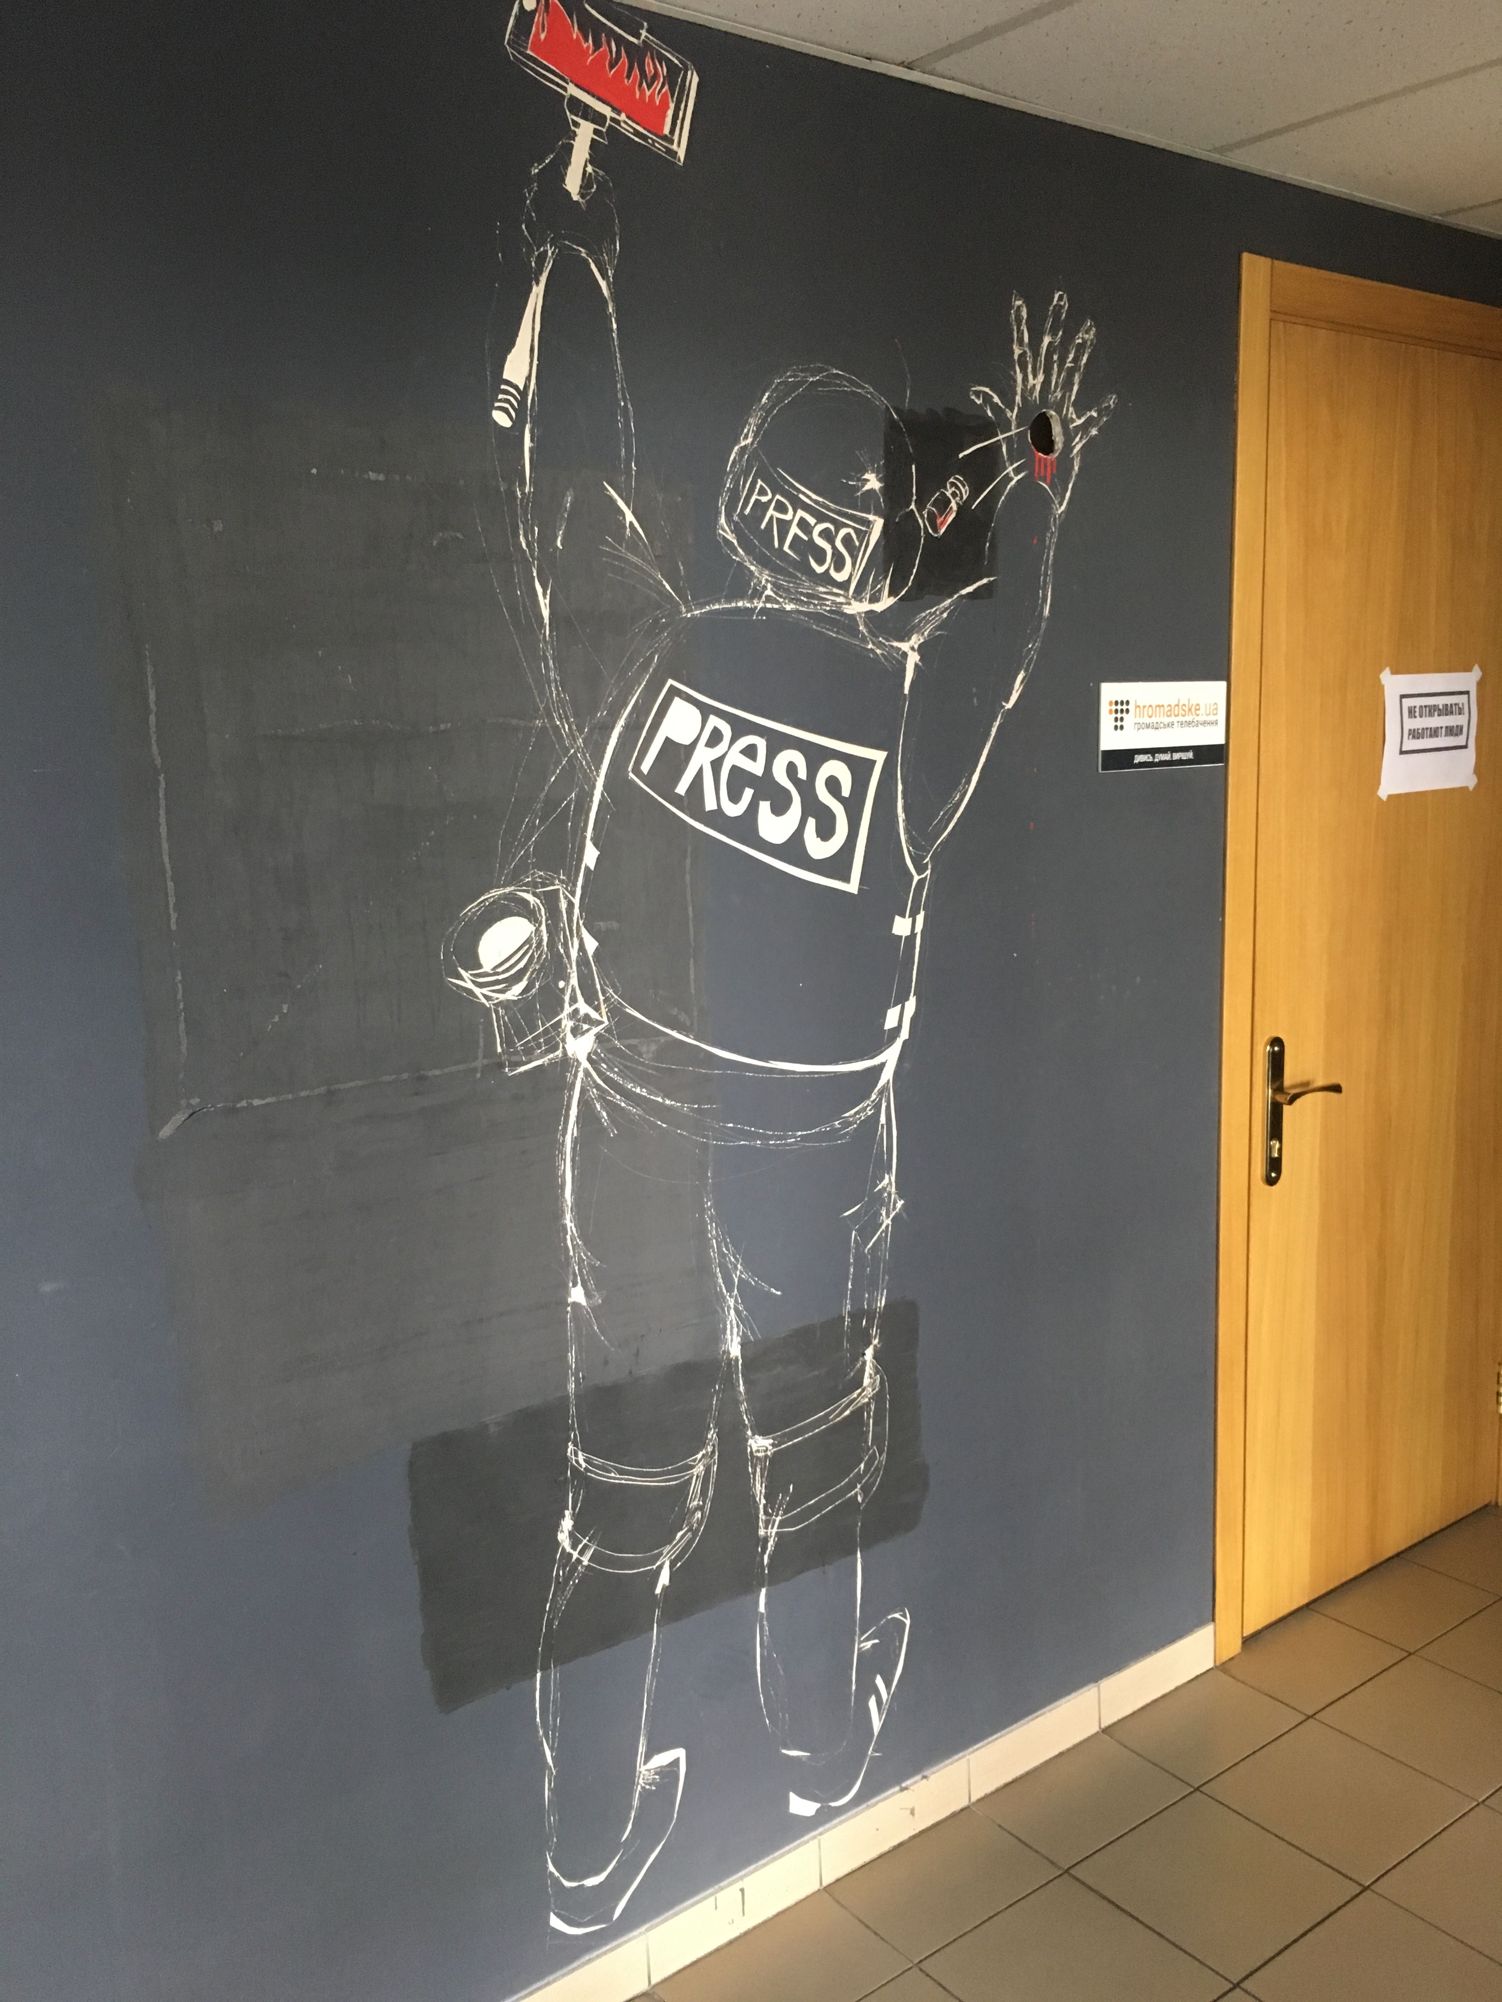
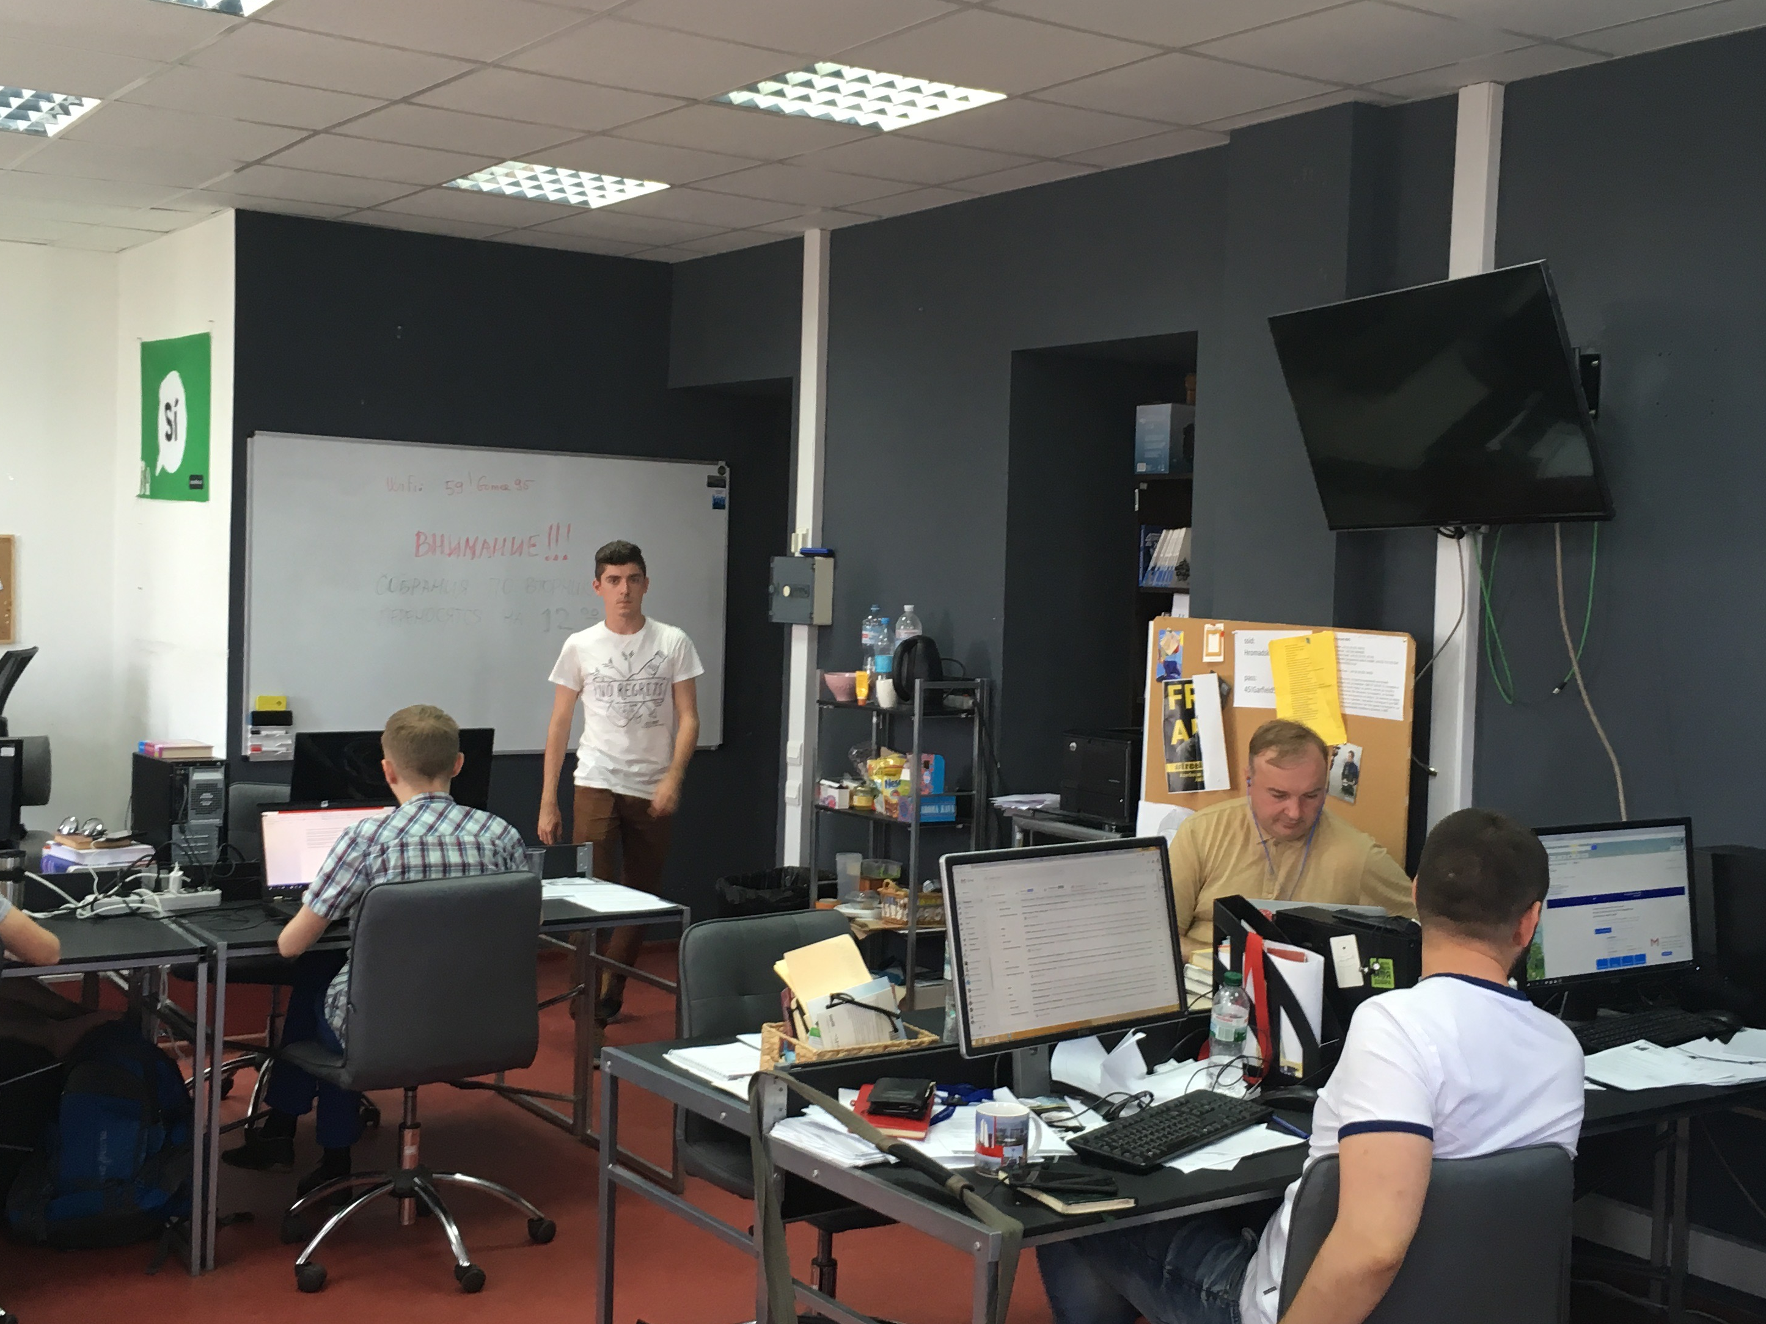
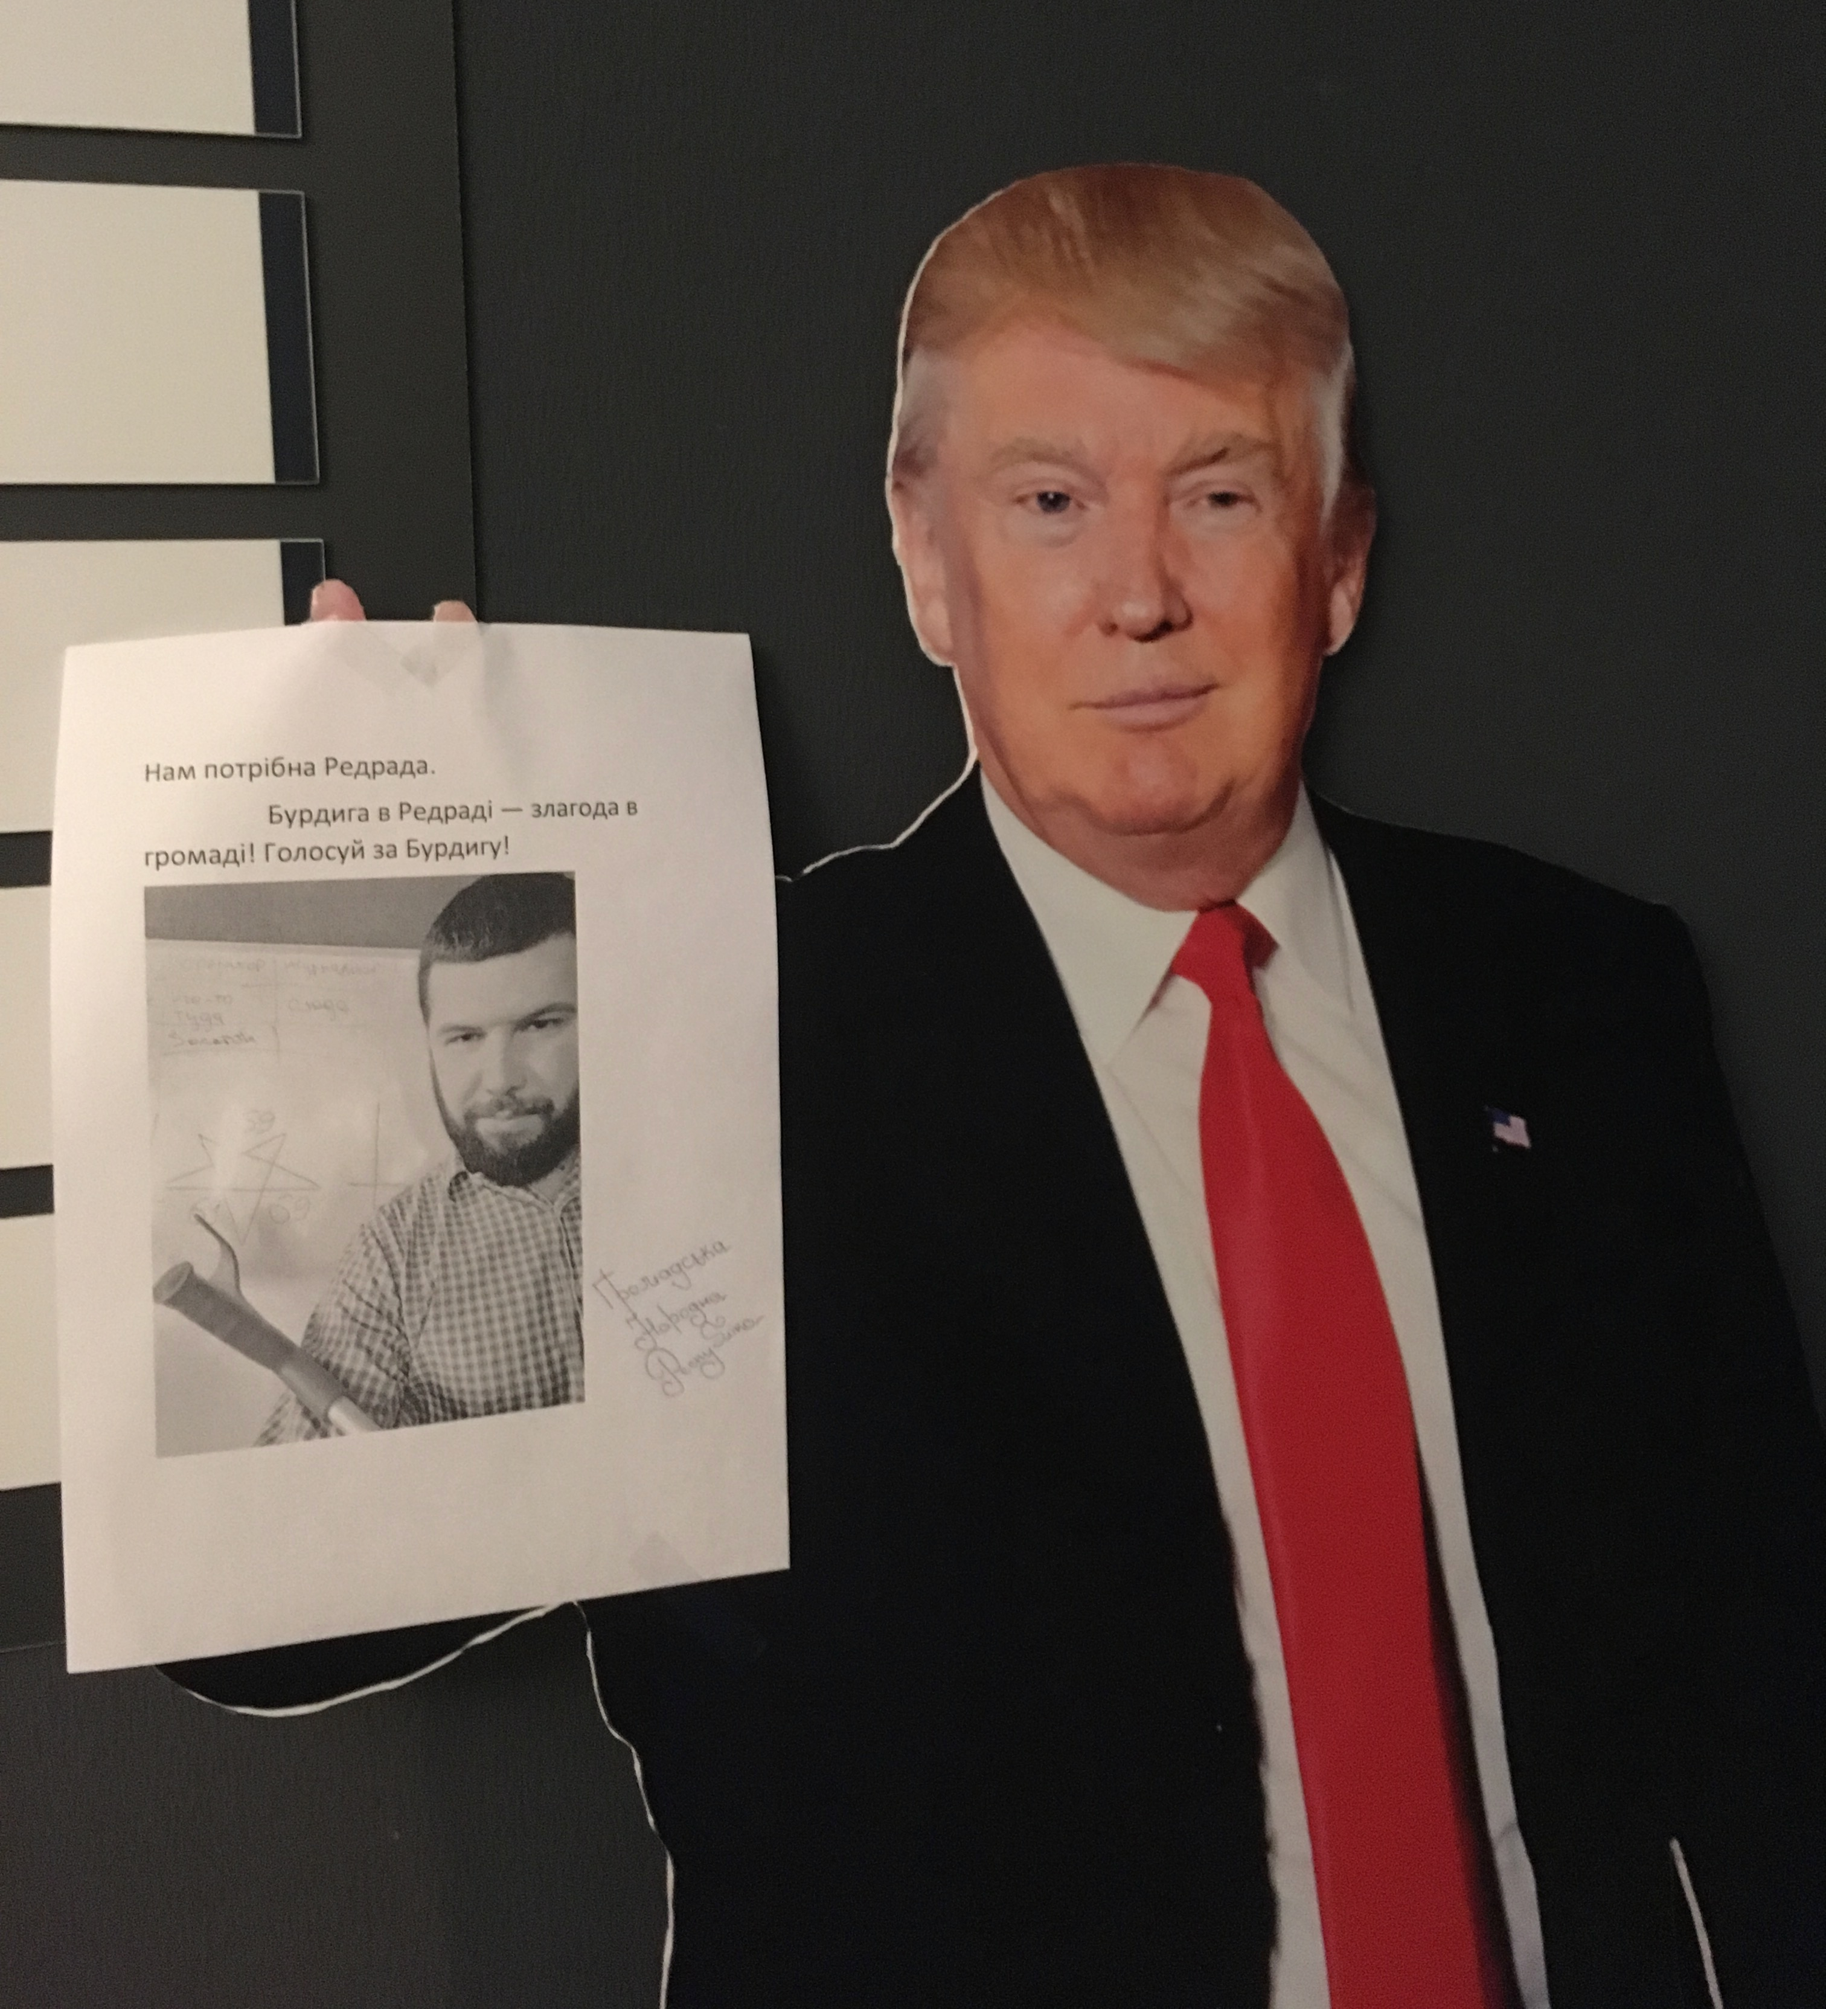
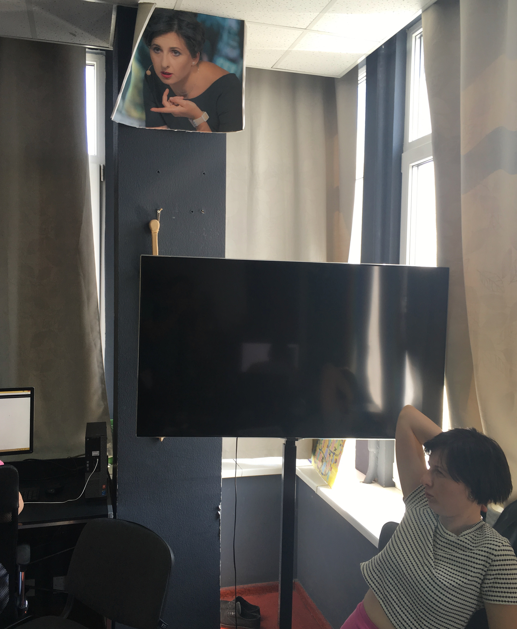
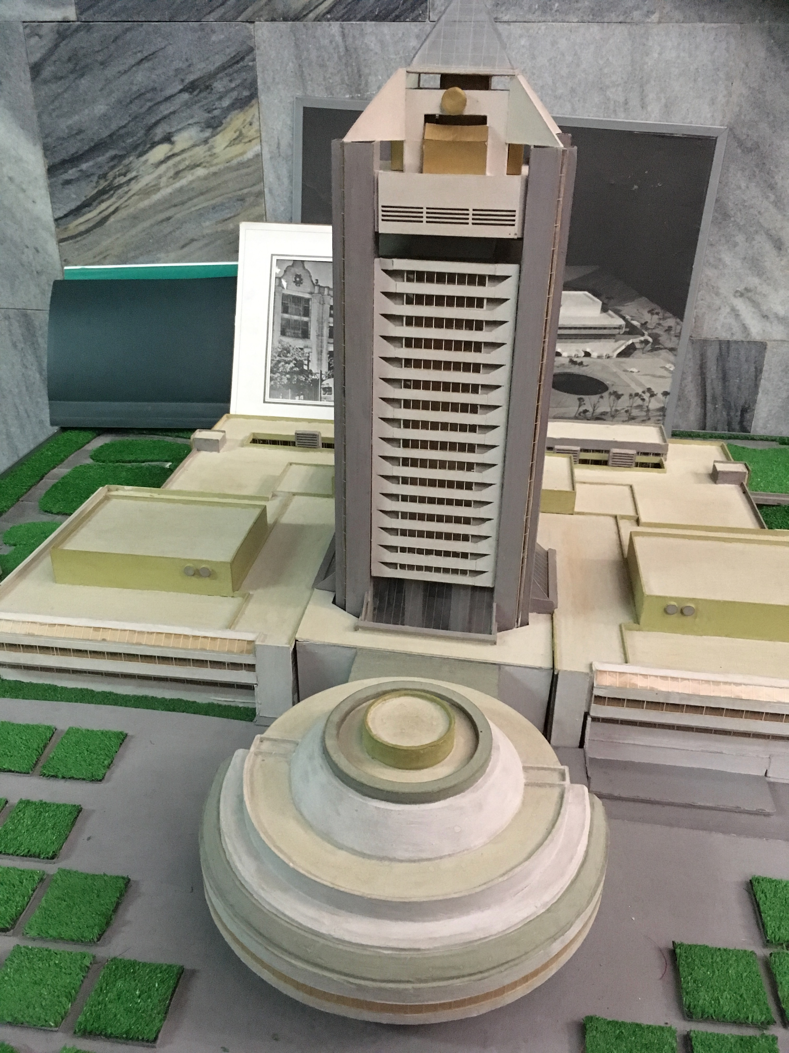
Author’s
photos

Slide 3
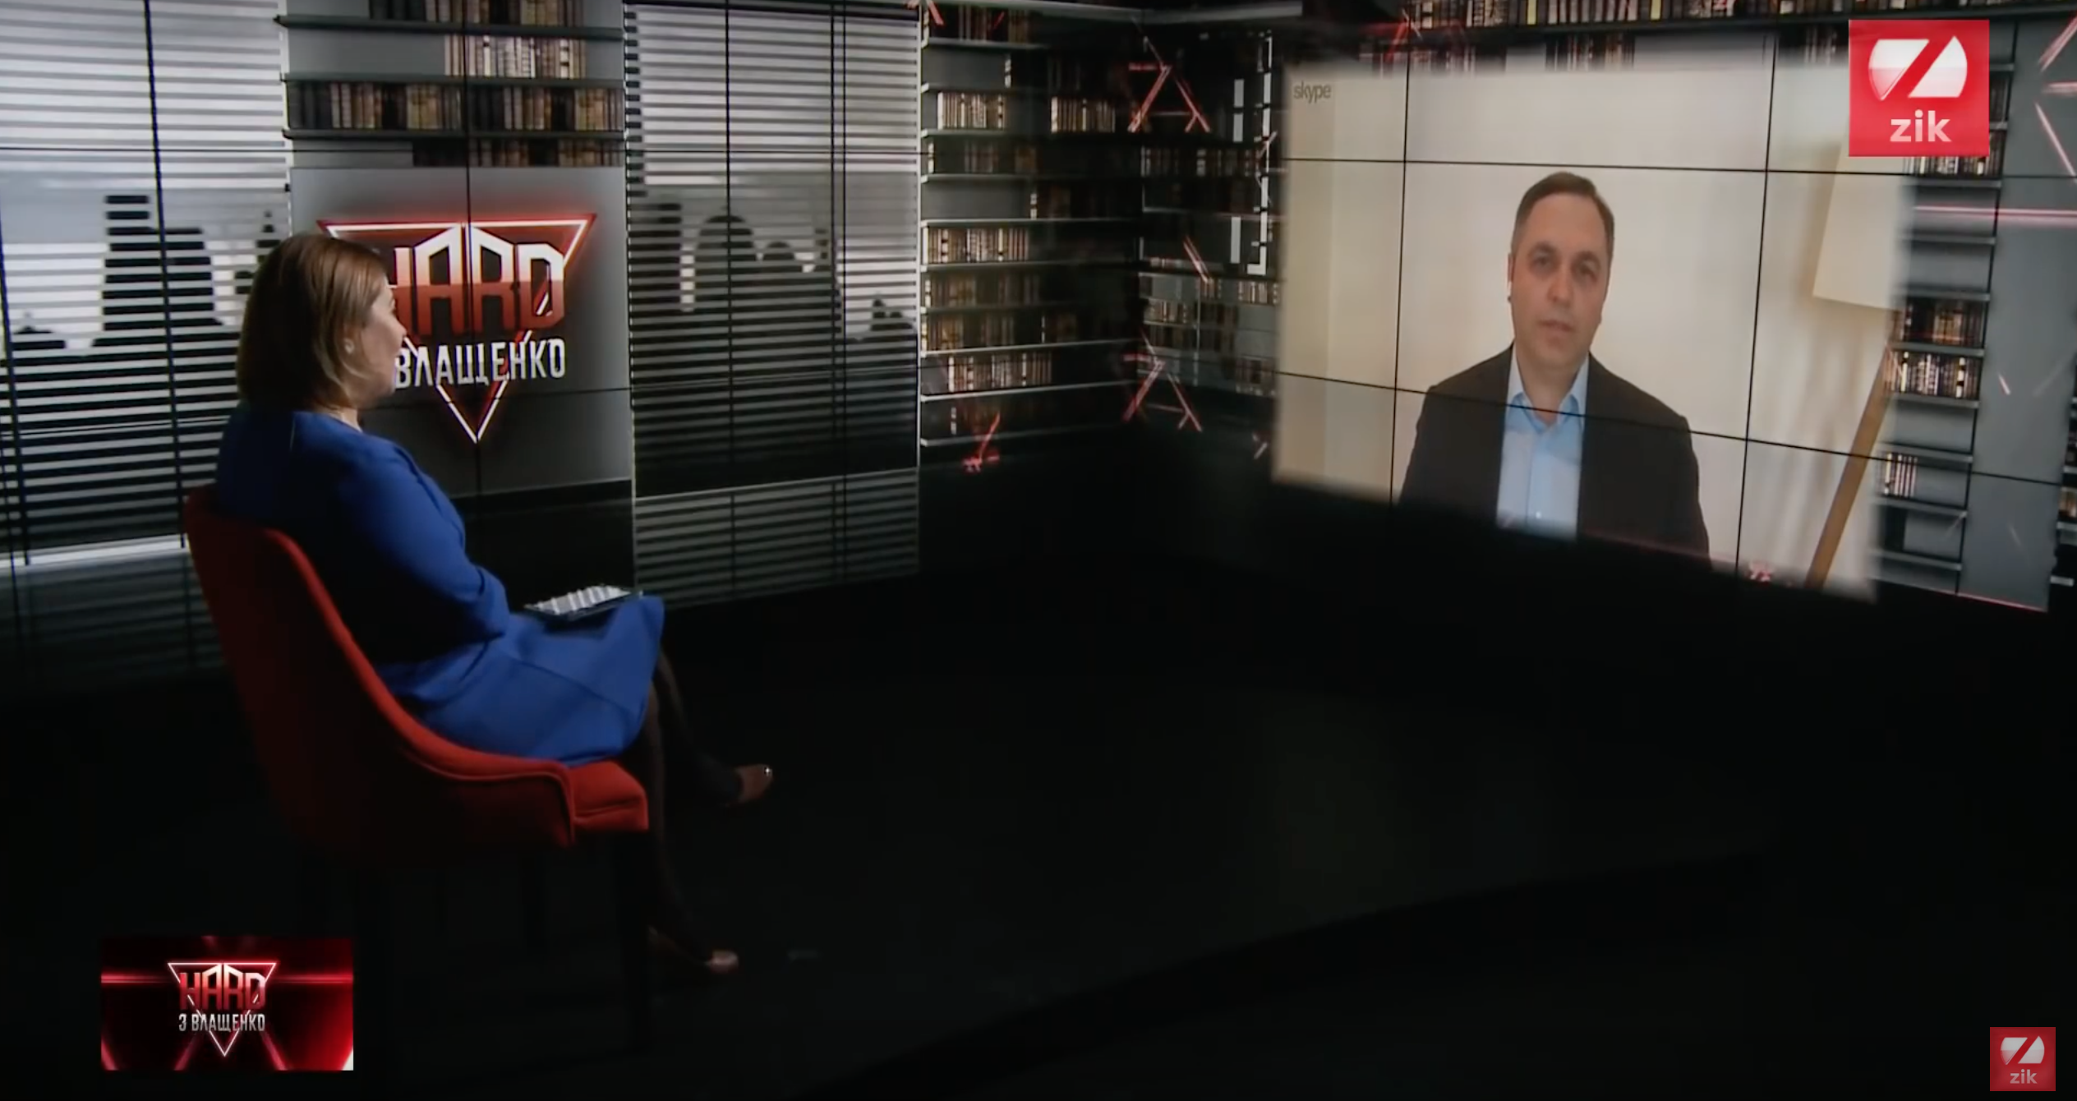
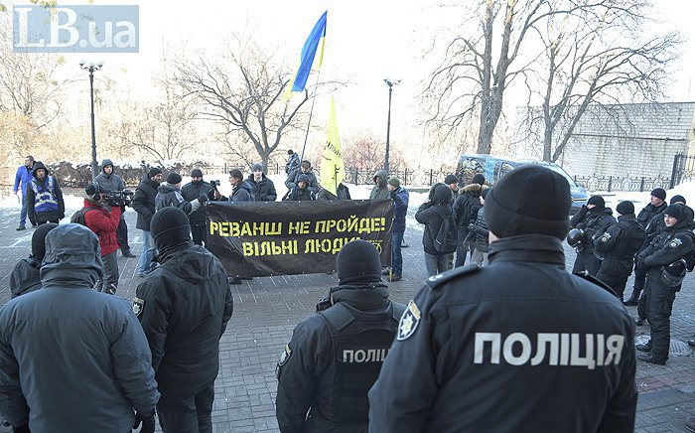
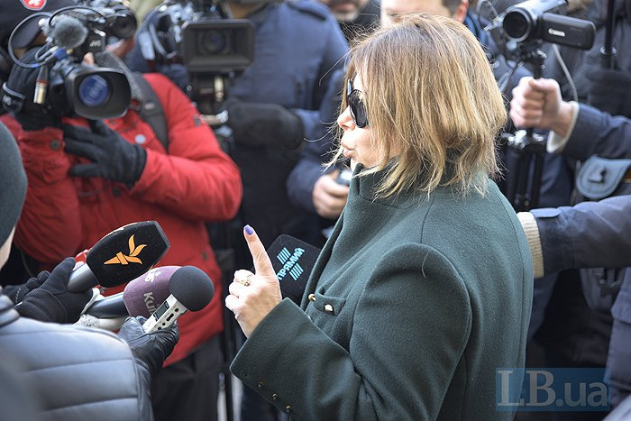
Sources:
ZIK,
LB.ua

Slide 4
June 2018: an event on professionalism in news coverage of Arkadiy Babchenko’s resurrection. Represented Suspilne, Hromadske, UCU, IMI, Detector Media, RFE/RL and the donor community
Author’s
photo

Slide 5
Thank you!
tf338@cam.ac.uk
@peasantpedant

