Slide 1
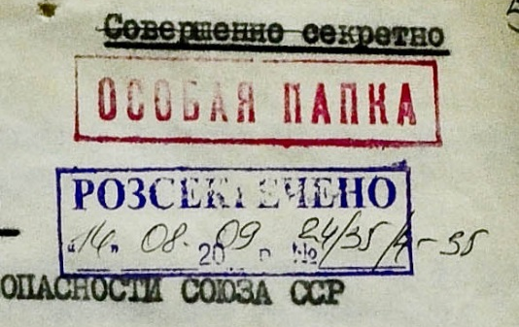
Operation “Zapad” (“West”): the Forcible Deportations of Ukrainians as an Instrument of Soviet Counterinsurgency
Andriy Kohut

Slide 2
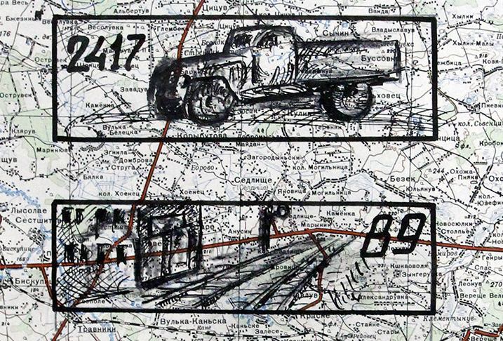
Research Hypotheses / Questions
Roots of deportation operation
Poland experience / sample
Development of kolkhozes or counterinsurgency

Slide 3
Stalin’s Deportations from Western Ukraine
 | Deportation operation or campaign | Dates | Number of deported
 |  |  | families | persons
1 | Operation on osadniks and foresters | February 10-11, 1940 | 17 203 | 89 079
2 | Operation on prostitutes | April 8-9, 1940 | — | 737
3 | Operation on the families of the repressed | April 13, 1940 | 10 475 | 32 076
4 | Operation on the refugees | June 28-30, 1940 | 37 932 | 83 207
5 | Operation on the families of counterrevolutionaries | May 22, 1941 | 3 079 | 11 329
6 | Campaign on the OUN families | 1944-1946 | 14 729 | 36 609
7 | Operation “Zapad” | October 21-26, 1947 | 26 332 | 77 791
8 | Campaign on the OUN families | 1948–1952 | 22 308 | 80 209
9 | Campaign on the kulaks | 1947–1951 | 4 529
10 | Operation “Troika” | April 8, 1951 | 2 487 | 8 984

Slide 4
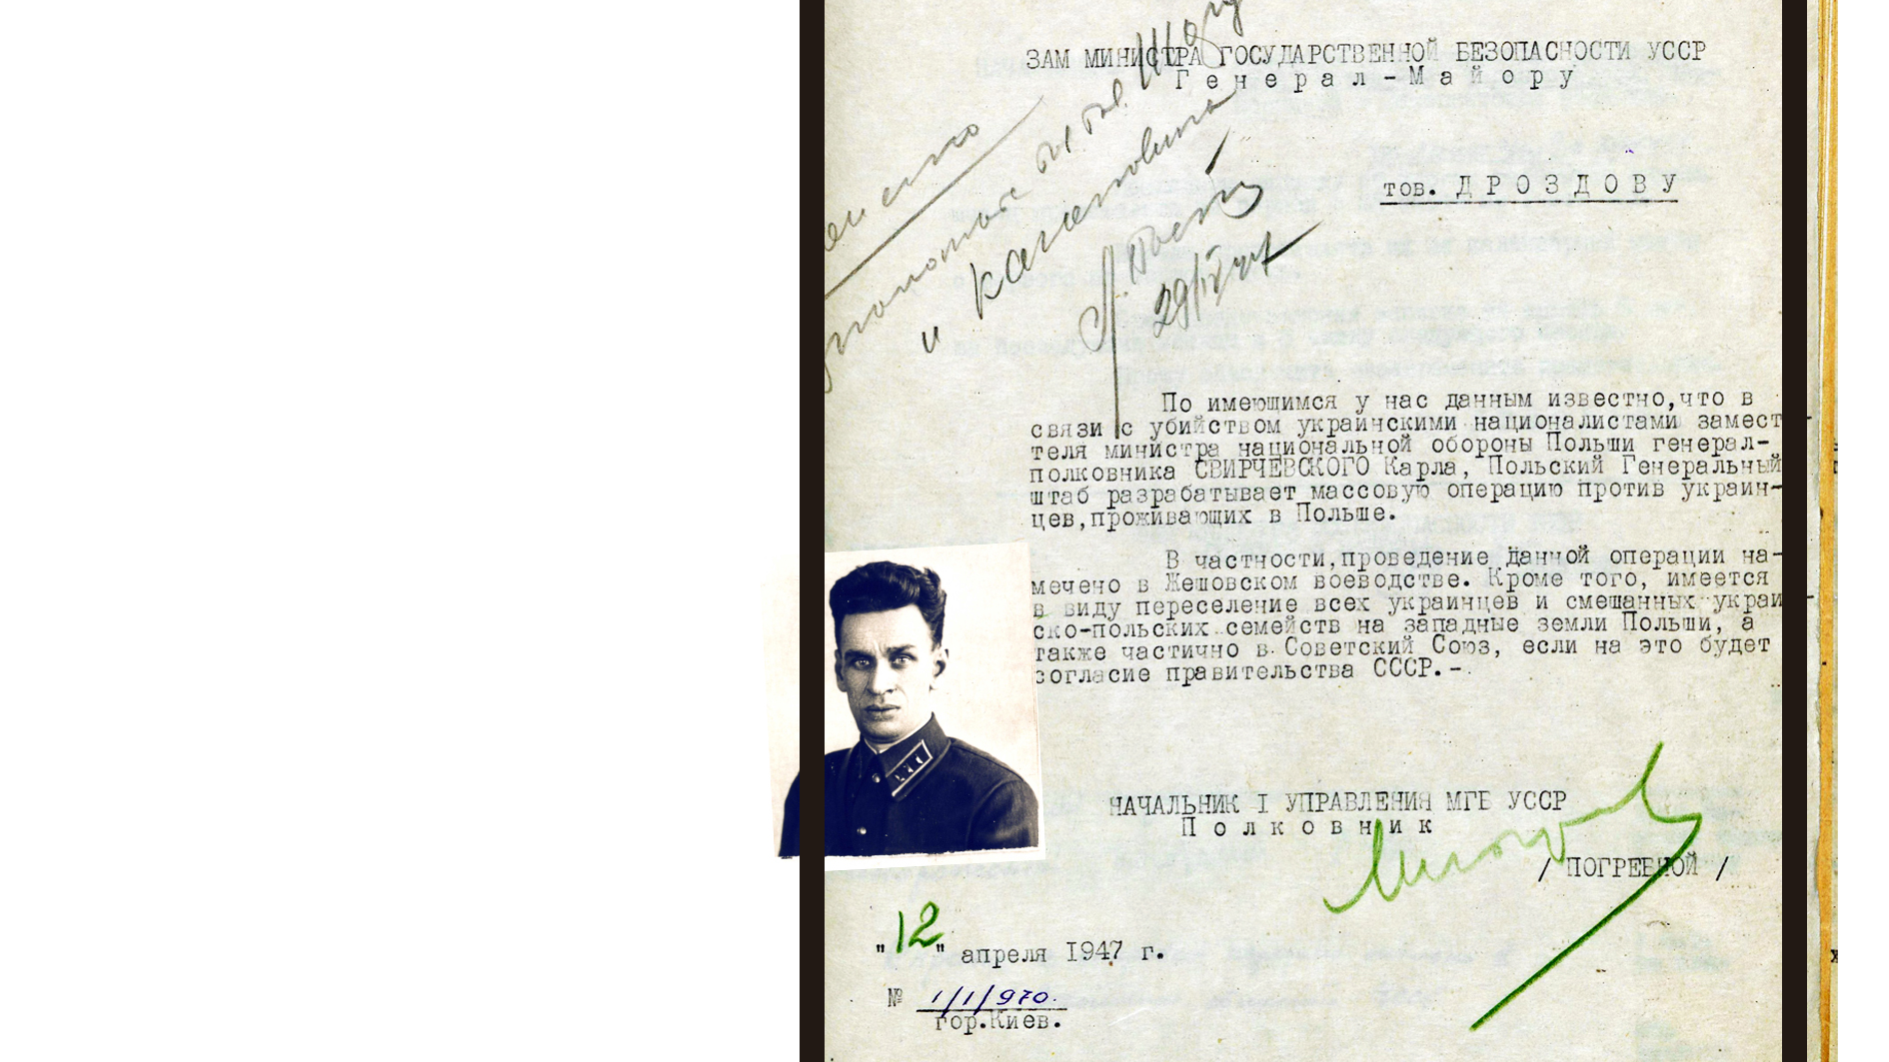
Operation “Wisla” and Deportation from Western Ukraine in 1947

Slide 5
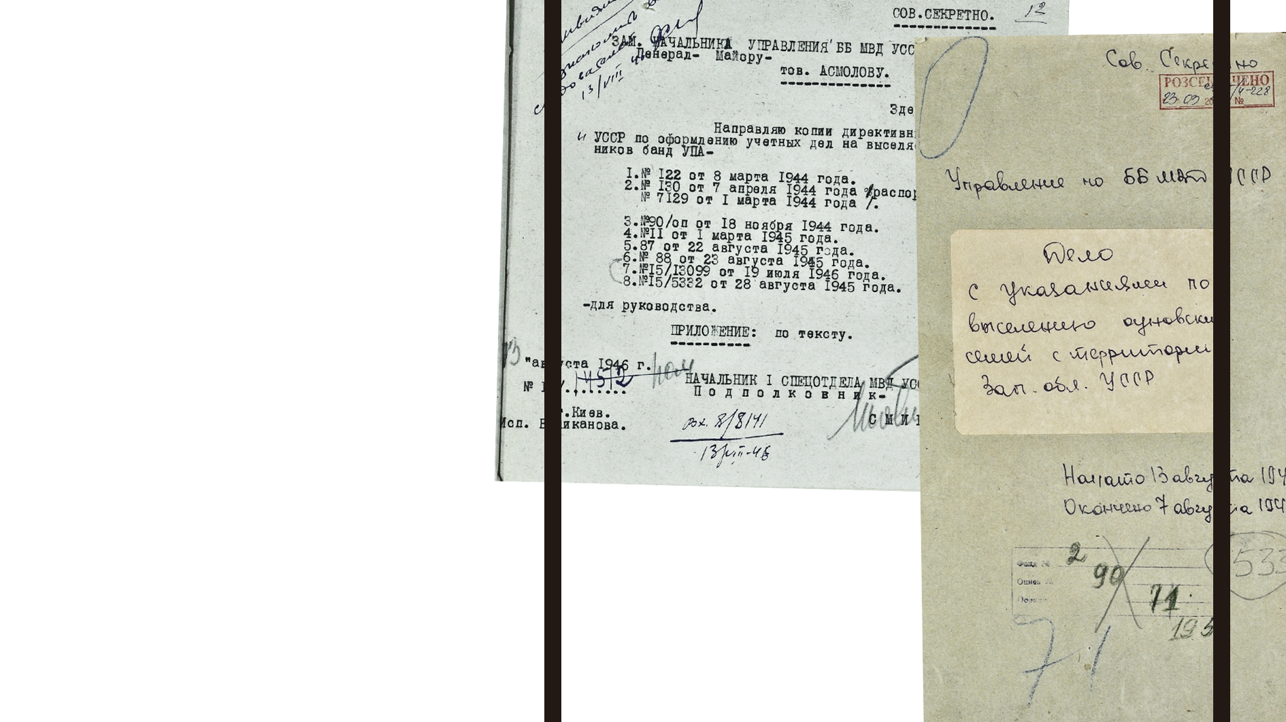
Soviet Secret Services
Regulatory Acts
Regarding Deportation 1944–1947

Slide 6
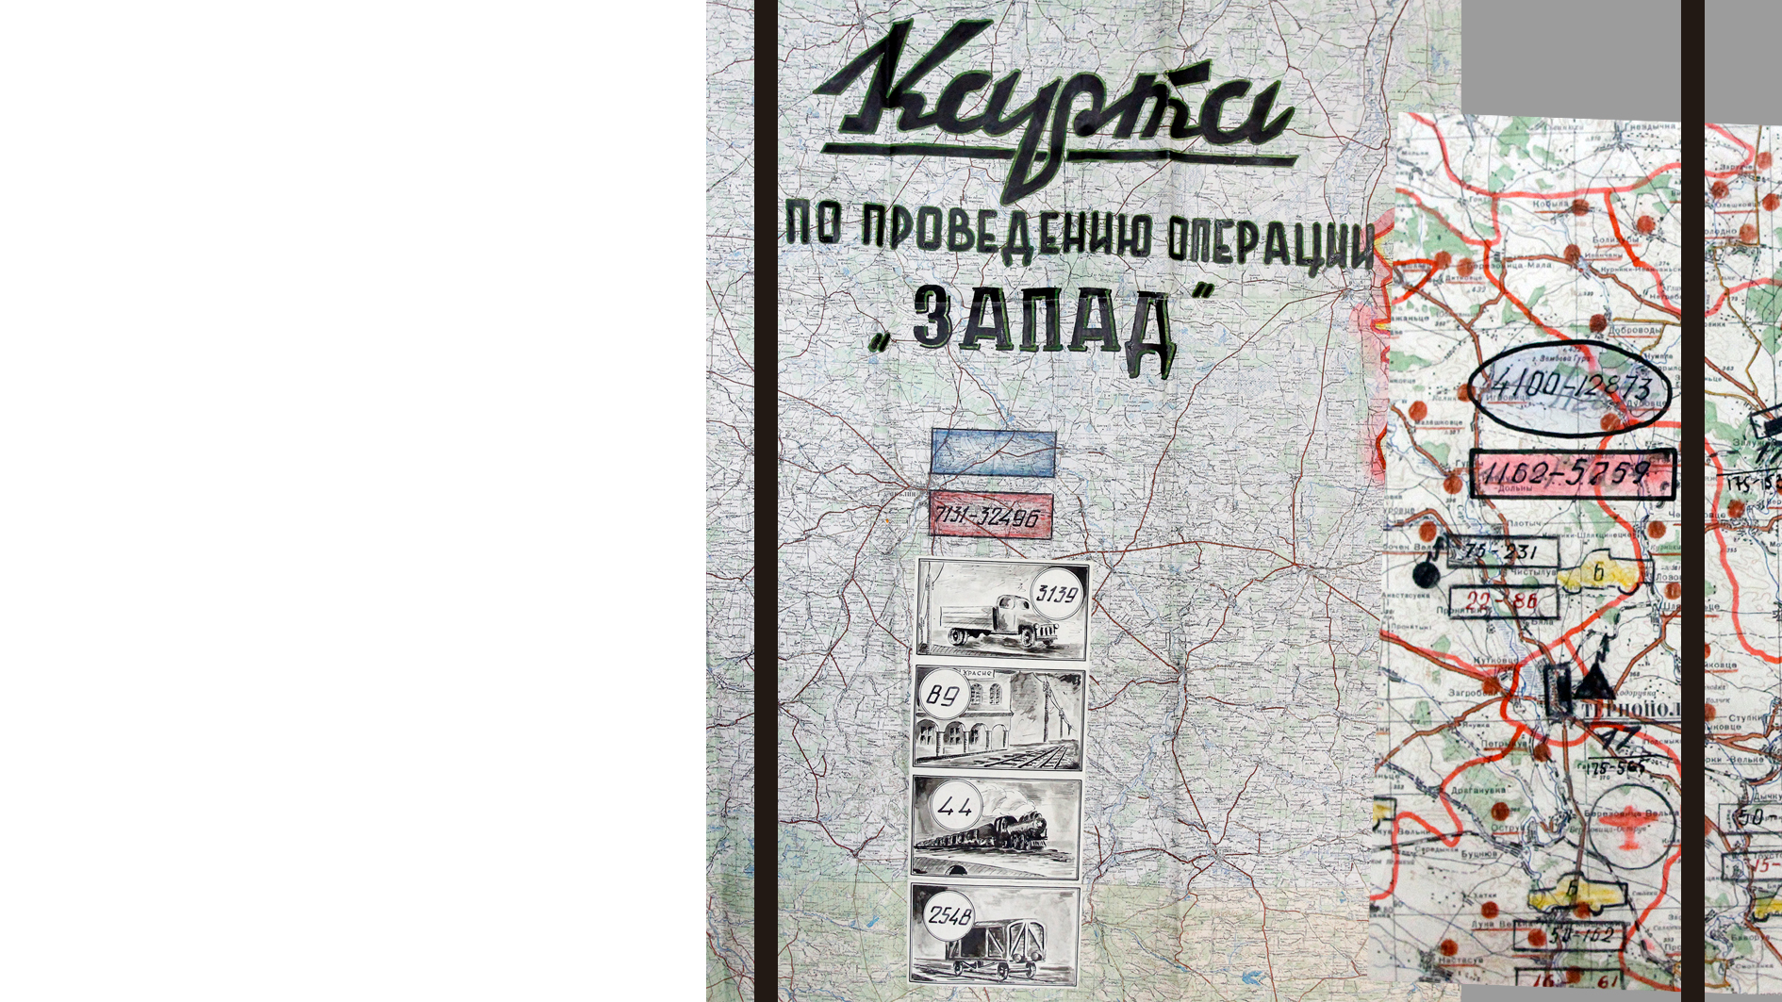
Operation “Zapad” Order MGB USSR № 00430 October 21-26, 1947
Deported:
26 332 families
77 791 persons
of them:
18 866 men
35 685 women
23 240 children

Slide 7
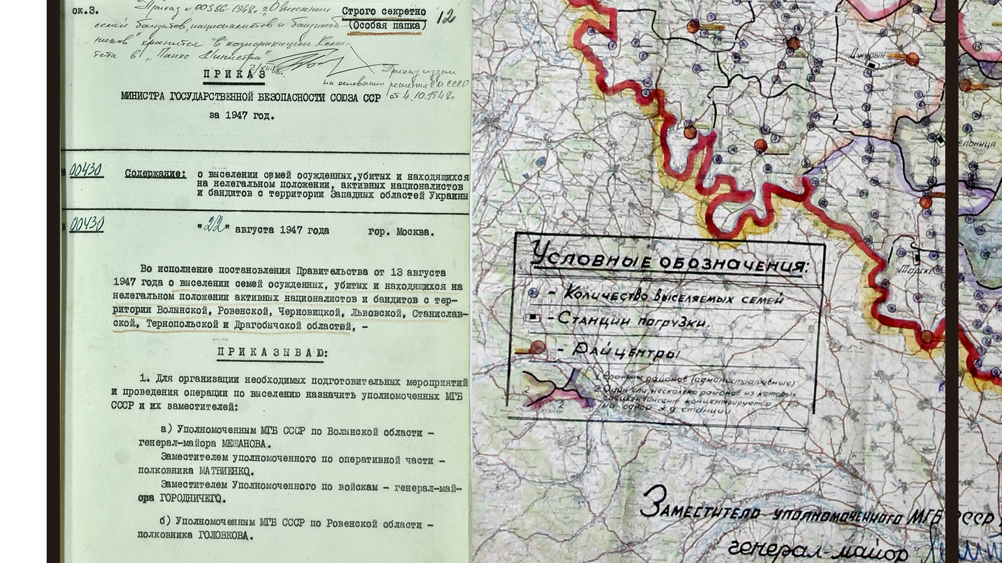

Slide 8
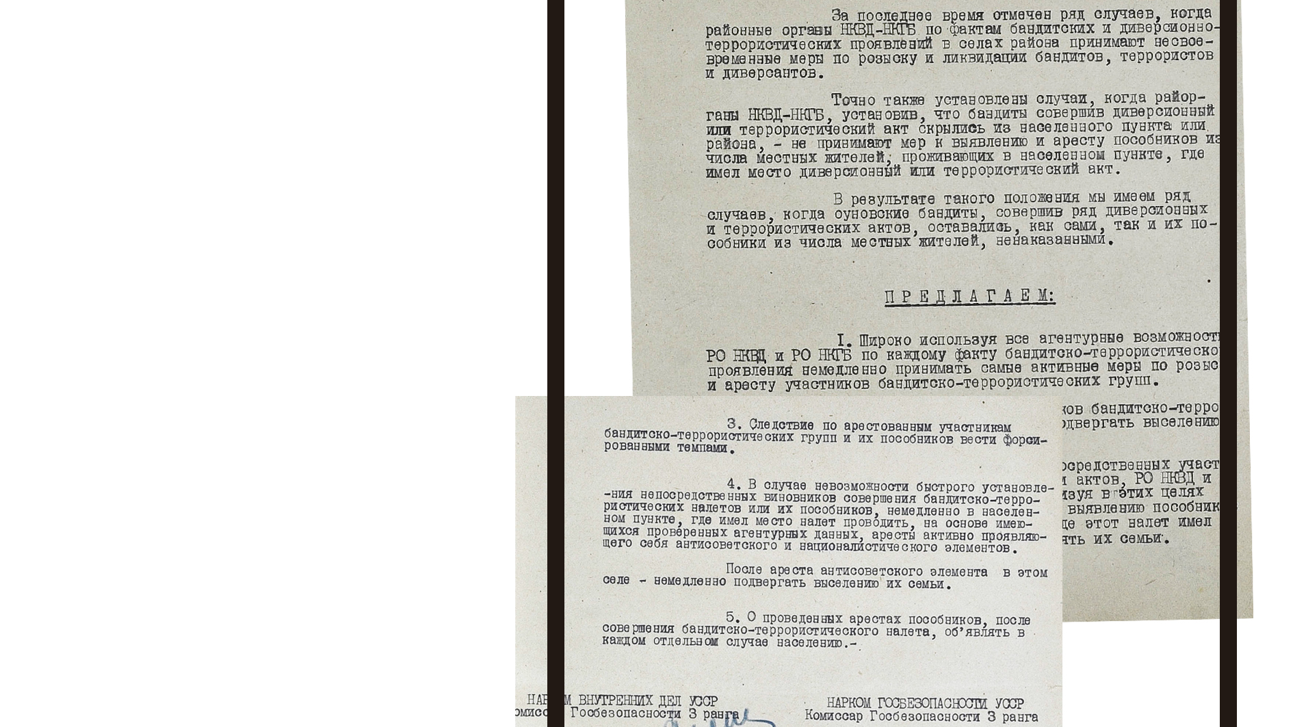
Directive NKVD and NKGB Ukrainian SSR № 48/д/31 May 24, 1945
phenomenon of civil hostage

Slide 9
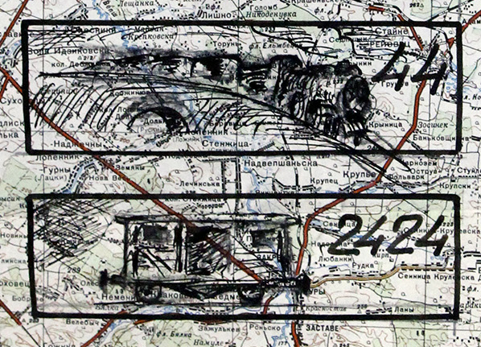
Thank you!
Andriy Kohut

