Slide 1
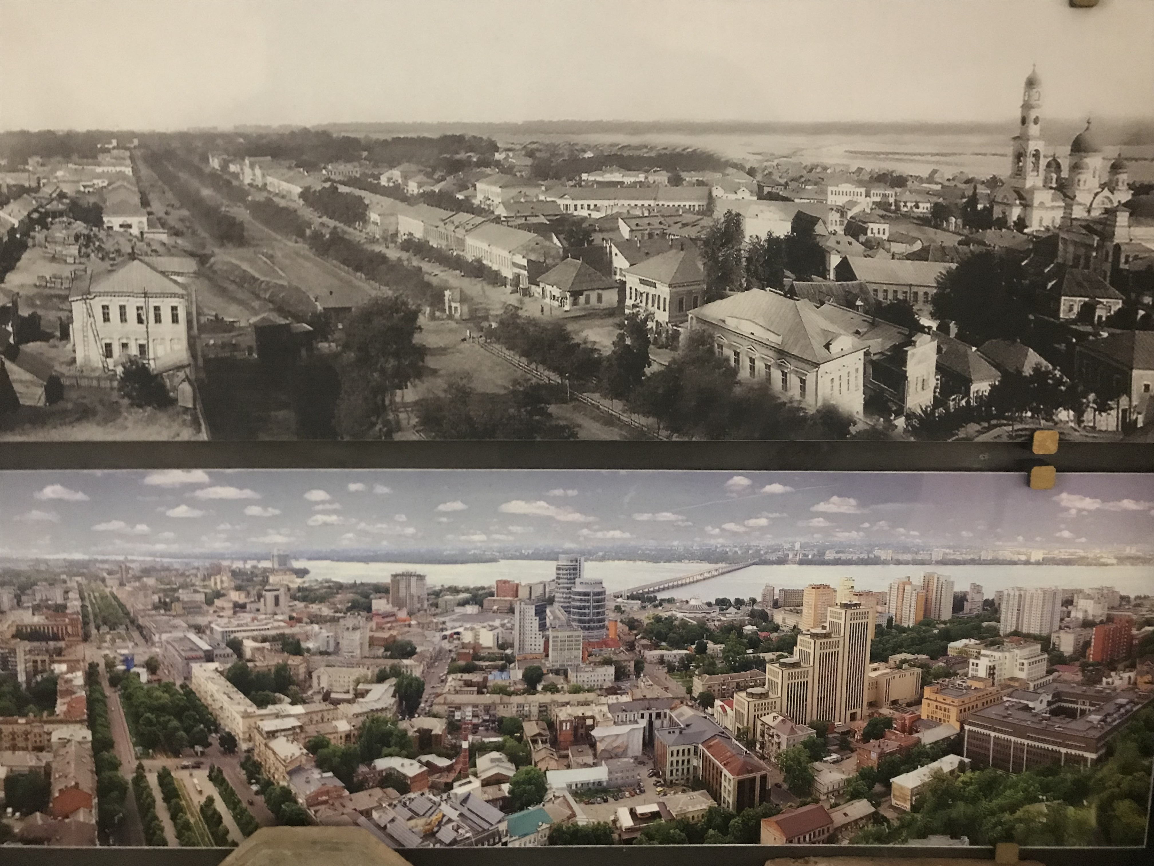

Slide 2
The Securitization of Entangled Historical Identity? Local and National History Discourses in Dnipro During the Poroshenko Presidency
Ursula Woolley
1/10

Slide 3
Outline:
Popular historical narrative
Local value of history
Major public projects
National content providers
Local response
Discursive journey of local tropes
Conclusions and questions

Slide 4
Popular historical narrative: It was relatively easy to construct a narrative of recurring success around the history of Dnipro.
Notes:
The high points were all about importance and glory - for the city
So ‘before’ - the Cossack trading post - doesn’t really count and around - the Holodomor in the surrounding countryside - doesn’t really feature either -
But the retention of self-esteem through history is consistent

Slide 5
Local value of history: There was also the legacy of an apparently conscious construction of a discourse of the importance of history for its own sake.
Notes:
So the interest in the national past and in the romance of the Cossacks was well-timed with the economic boom of the nineteenth century and the national awakening which went with it and this was personified by Iavornyts’kyy
The contribution of Koval’skyy and Honchar - the two sides of the relationship with the northern neighbour
We can see in the responses of local politicians of both sides that this was the case - and this plays into the important point about using tropes which we discuss later below

Slide 6
Major public projects:
Museum of Jewish Memory and the Holocaust in Ukraine
Rocket Park
Stara Samar’ (!)
ATO Museum at the WWII Diorama of the Battle of the Dnipro River
Notes:
The difference between narrative for an external audience - keeping the messaging going about the Cossacks - and local construction of identity
Facts about the different projects
So how do we characterize this response - or these different responses - to Russkiy Mir - which had been present for some years by this time

Slide 7
National content providers: Istorychna Pravda and the Institute of National Memory superimposed different emphases and different strands onto the local narrative of historical identity.
Notes:
The national content providers were working on a certain limited range of narratives.
The local messages about efficiency and pro-Judaism were taken up and used.
Unlike in other smaller places where they had imposed more, here they weren’t really able to because there was this local historical identity infrastructure in place

Slide 8
Local response: The Dnipro approach to Decommunization was supportive and cooperative but by no means comprehensively so.

Slide 9
Discursive journey of local tropes:
‘More Cossack Siches than Zaporizhzhia’
‘A Southern Capital of the Russian Empire’
‘The Manchester of Ukraine’
Victors in the Great Patriotic War
‘Rocket City’
‘The Talent Pool’

Slide 10
Conclusions: discourses of history in Dnipro: ‘entangled history’ and ‘mnemonical security’?
“A genuinely agonistic mnemonic pluralism…”
Maria Mälksoo 2015

Slide 11
Thank you - Questions?

Slide 12
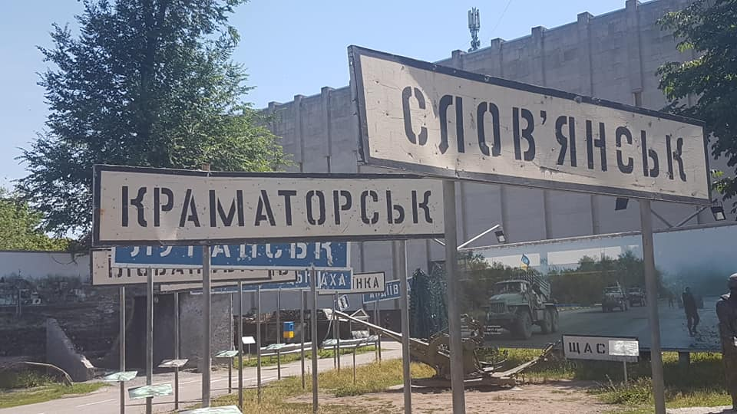

Slide 13
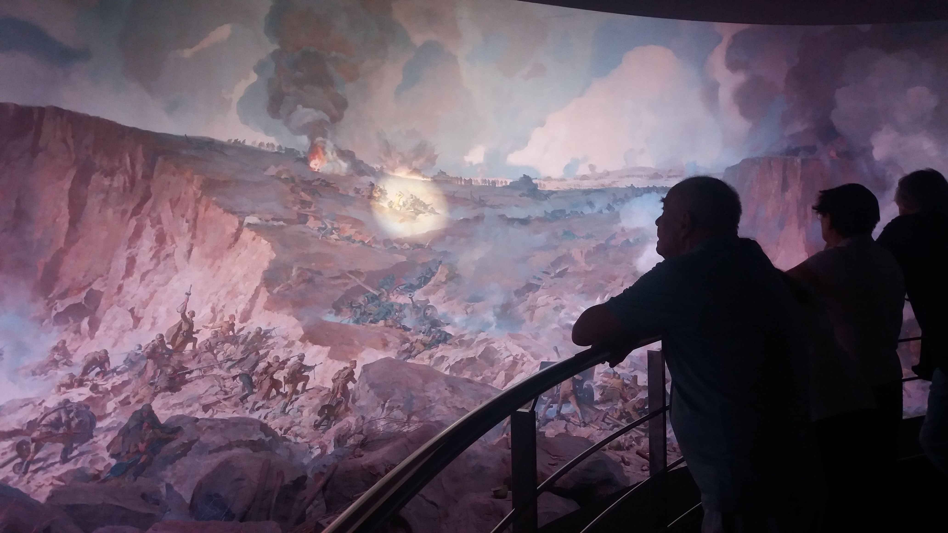

Slide 14
Acknowledgements & Reference
Forum Transregionale Studien e. V.
The Tkuma Ukrainian Institute for Holocaust Studies at the Museum of Jewish Memory and the Holocaust in Ukraine, Dnipro
Viktoriia Serhiienko (for images from the ATO Museum)
Denys Shatalov (for images from the Museum of Jewish Memory)
Iehor Vradiy (for images from the Museum of Jewish Memory)
Reference: Mälksoo, M., “‘Memory Must Be Defended’: Beyond the Politics of Mnemonical Security”, Security Dialogue, 46, 2015, 3, p. 221.

